Slide 1
Developing reading fluency
CORE - Center at Oregon for
Research in Education
A Project LIFT Training Module
Module 4 – Part 2
Notes:
This is the Module 4, Part 1 presentation on development reading fluency. This is a particularly new topic for many teachers in the FSM. As such, it is important to go through the materials and accompanying activities slowly in order to fully understand the concept as well as the role fluency plays in overall reading development.

Slide 2
What should the reading block look like?
Early Elementary
Phonemic Awareness Warm-Up (5-10)
Introduce or review sound/spelling (explicit)(10-15)
Decodable Readers (10)
Robust Vocabulary Instruction (15)
Pre-Reading Activities (5)
During Reading Activities (20)
After Reading Activities (10-15)
Notes:
Instruction and practice on reading fluency can occur a number of places during daily reading instruction either during whole group instruction or during small group instruction in Tier 2. Ideas for incorporating reading fluency into your reading curriculum will be discussed throughout this presentation.

Slide 3
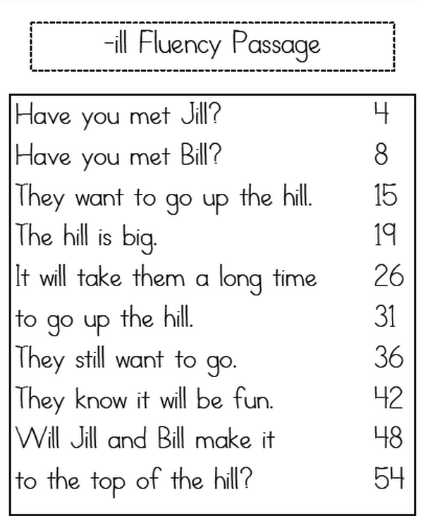
Types of Fluency Instruction
Letter-Sound Level
Blending
Word Level
Phrase Level
Connected Text
Notes:
When many educators hear the words “fluency development,” they automatically think of fluency development at the connected text level such as in reading passages or books. However, for young readers, as well as older struggling readers, fluency development starts at a much more basic level. Let’s take a look at fluency development of these lower level skills.

Slide 4
Critical Elements of Fluency Instruction
Schedule sufficient practice (brief, multiple opportunities each day) with corrective feedback.
Systematically increase the rate of response (set goals). Graph or chart learner performance.
Differentiate instruction based on student needs
Remember: Fluency instruction is not a replacement for reading instruction. It is only part of the picture.
Notes:
Before doing so, however, let’s look at some general critical elements of fluency instruction no matter if a teacher is working on fluency at the letter-sound level or passage level.
Certain critical elements of fluency instruction have been shown to increase student gains. Sufficient practice, through brief, multiple opportunities each day, should be provided along with corrective feedback. For example, after whole group instruction has taken place, students can work with partners for 10-15 minutes on reading fluency, Or, during differentiated Tier 2 reading time, a couple of days each week could be spent on fluency development depending on if the child needs practice with letter sounds, sight words, etc.
Goals should be set that allow students to systematically increase the rate of responses.
It is important that teachers continue to differentiate instruction based on data and student needs, and keep in mind that fluency instruction is not a replacement for reading instruction. Teachers should remember that integrating reading fluency opportunities into your weekly lesson plan takes time. Teachers must decide at what level fluency practice should happen, prepare the materials, model for students how fluency practice should be conducted.

Slide 5
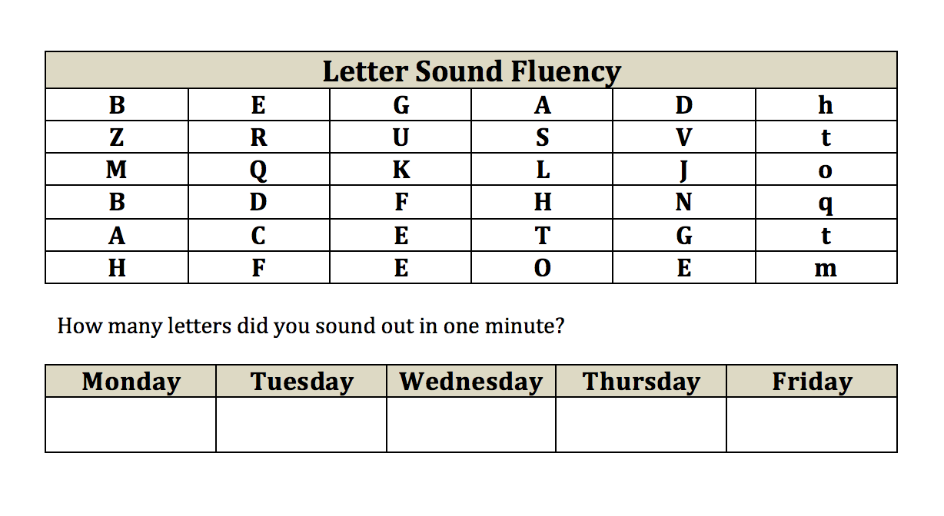
Letter-Sound Automaticity
Notes:
Let’s start with ideas for letter-sound automaticity.

Slide 6
Lesson Design Considerations
General Guidelines
Develop a set of letters that have been previously introduced through direct instruction (will change as new letters are introduced)
Include multiple examples of each letter-sound in the practice set.
Notes:
To work on letter-sound fluency, first develop a set of letters that have been previously introduced through direct instruction (will change as new letters are introduced).
Then develop a matrix with those letters into a practice set. Students are then given one minute to read as many letter sounds as possible within one minute.

Slide 7
Lesson Design Considerations
Goal: Students should be able to respond to each letter-sound within one second.
Remove letter sounds identified accurately and automatically for two consecutive weeks.
Reteach sounds on which students make errors.
Notes:
The goal is for students to be able to respond to each letter-sound within one second. Use the matrix on consecutive days in a week to see if students can increase their fluency (for an example, see the previous slide).
As students master letter sound, they should be removed from the set and used only occasionally for review.
If you notice that particular students are having difficult with certain letters, go back and reteach that letter.

Slide 8
Module 4, Activity 2
This activity demonstrates how a teacher can use the guidelines listed on the previous slide to create two activities for letter-sound practice.
Complete the activity as shown. Then return to the presentation.

Slide 9
Blending Automaticity
Notes:
Let’s move on to building fluency with blending sounds into words. This can be a difficult skill for some children.

Slide 10
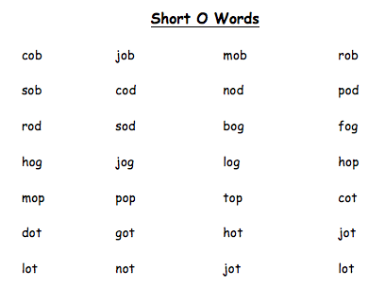
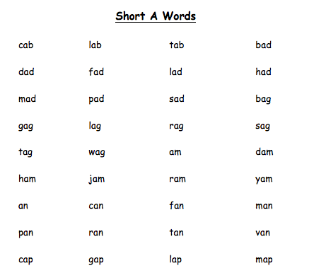
Blending Automaticity
Notes:
Blending is the ability to smoothly and fluidly combine individual sounds or phonemes in a word together into a meaningful word. Research from the National Reading Panel report indicates that students’ achievement levels increase when students are explicitly taught blending skills.
While many students learn to blend with ease and automatically, some do not. These are the students who require specific direct instruction and continual practice in order to acquire this skill. Fortunately, there are strategies teachers can use to help students learn how to blend sounds.

Slide 11
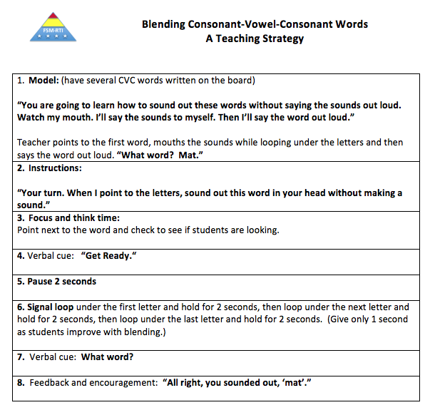
Blending Automaticity: A Beginning Teaching Strategy
Notes:
For students who do have difficulty picking up the ability to blend sounds, the resource Resource 3, an activity entitled, “Blending Consonant-Vowel-Consonant Words is a teaching tool designed to increase the beginning blending skills of young students in the early grades. It includes both modeling of how to sound out the sounds within words in their head and then say the entire word out loud as well as multiple opportunities to practice the skill of letter-sound blending. The strategy can be found on the screen as well as in Module 4 materials.
Take some time now to look over this strategy. Then, if time is available and working with a partner, develop a set of CVC words. Take turns practicing this strategy with your colleague.

Slide 12
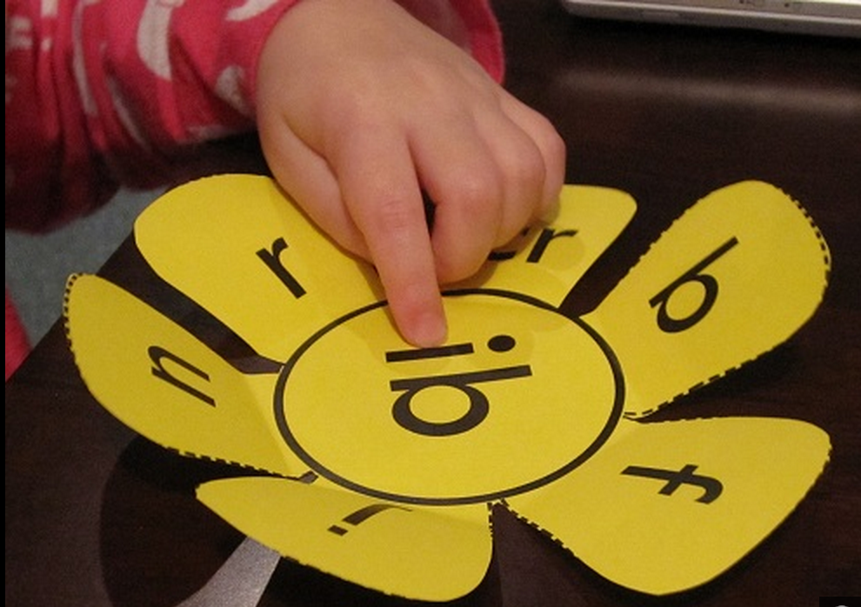
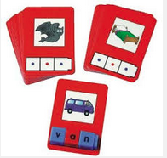
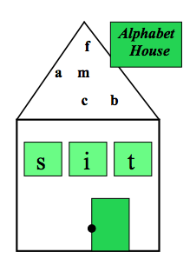
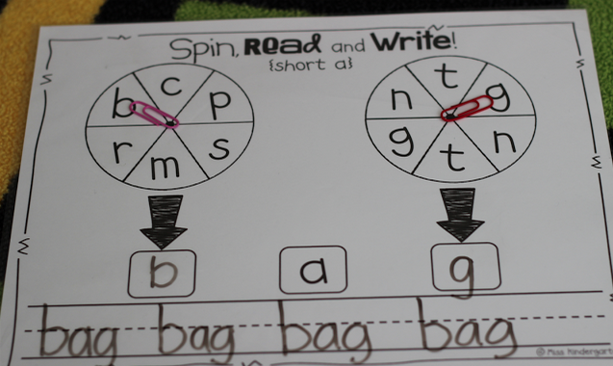
Blending Fluency Practice
Many resources and ideas are available to practice CVC words:
http://www.havefunteaching.com/activities/phonics-activities/cvc-activities
http://www.funfonix.com/book1/
(Example website with free materials for blending practice)
Notes:
There are many, many other ways for students to practice the skill of blending. A few are shown on the screen along with a couple of websites where free materials are available for download. The point is that teachers will need to be creative and use their prep time to create some of these materials. These materials can then be used over and over again. Use whatever materials your school happens to have available to create the materials. You may want to consider using a parent to help create these materials as well. The activities can be used with the whole class. They would also be wonderful to use for small group Tier 2 or 3 instruction.

Slide 13
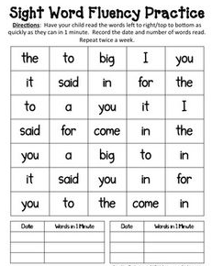
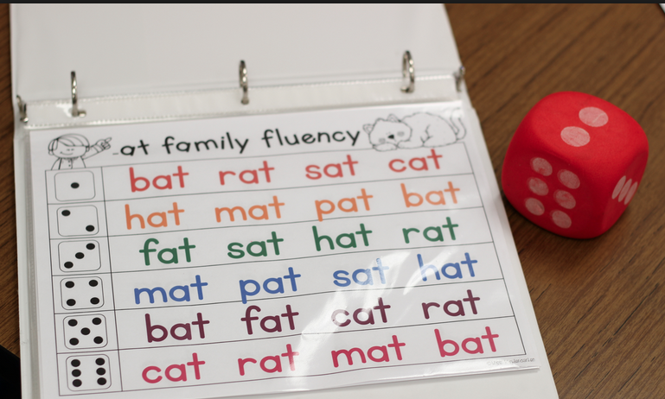
Word Reading Automaticity
Notes:
Words-Reading automaticity is the next level of fluency we will explore.

Slide 14
Word Reading Automaticity
Partner Practice. Pair a higher performer with a child who needs fluency practice. Use similar procedures as in One-Minute Dash. Each child may use his/her set of known but nonfluent words.
Word recognition grid. Prepare a 5x5 grid of 5 words. One word per row randomly ordered. Include a short review of words. Then, do a timed recall of the words.
Notes:
One way of building automaticity with sight words, words with irregular patterns, or word types with which a student is having particular difficulty, is to conduct fluency activities at the word level. Partner Practice and creation of a Word Recognition Chart are examples of such activities. With Partner Practice, a higher performing student is paired with a student who needs fluency practice. Use similar procedures as in indicated in the Rapid Sound Chart as presented in Activity 2. Each student may use his/her set of known but not fluent words. Remember that this activity is practice on words that the student has been taught and can decode, but not with automaticity. Preparing a word recognition chart with randomly ordered known, but non-fluent words is a similar activity with a time requirement involved.

Slide 15
Module 4, Activity 3
This activity introduces two activities for word reading fluency:
Sight Word Dash
Quick Reading Chart
Complete the activity as shown. Then return to the presentation.

Slide 16
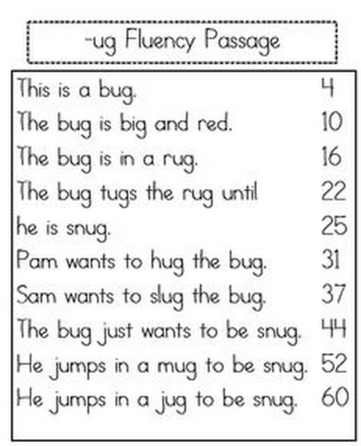
Connected Text Automaticity
Notes:
We’re now ready to move on to developing reading fluency at the connected text level. Again, “connected text” simply means reading phrases, sentences, and reading passages. Building fluency at the connected text level is a concept most familiar to many teachers. The next section focuses on this skill.

Slide 17
General Strategies for Building Connected Text Fluency
Most Common General Strategies:
Choral Reading
Repeated Readings
Options:
Phrase Level
Sentence Level
Passage Level
Notes:
Some of the more common strategies for developing connected text fluency include choral reading, timed repeated readings, and paired partner reading. We will briefly discuss each of these.
Teachers should remember that connected text fluency practice can happen using just phrases, single sentences, and passages. The teacher will need to determine what option is needed for various students in his or her classroom.

Slide 18
1. Choral or Whole Class Reading
During classroom instruction, teachers should limit the use of round robin reading (choosing one student, then the next student, then the next student, and so on).
Round Robin reading does not provide enough practice for students.
Choral reading is a one better choice. Students read together, as teacher walks around the room and monitors individual students’ reading.
Notes:
Fluency development can be an activity for the whole classroom as well as for partners.
Often teachers use round-robin reading, calling on individual children to read. But the disadvantages of round robin reading are numerous: 1) reduced amount of reading practice as it is distributed across many children, 2) voices that cannot be heard across the classroom, 3) embarrassed low-performing children, 4) off- task students, 5) management challenges emerging in the void when other students are not reading, and 6) boredom.
Instead, teachers should try to incorporate other procedures including choral reading when reading stories within their classrooms.

Slide 19
1. Whole Class Oral Reading
Teachers can use a mix of techniques for whole class reading:
Choral Reading
Cloze Reading
Silent Reading with Pre-Reading Questions
Partner
Small Group Individual Turns.
Resource: Alternative Procedures for Whole Class Reading.
Notes:
There are a number of alternatives that teachers can use to round robin reading. Some of these are listed on a screen. Generally, a teacher would want to pick two or so to use during one class period. Each of these are explained in the Handout Alternative Procedures for Whole Class Reading.
Practice Activity #2 gives you an opportunity to learn about various ways to incorporate whole class fluency practice into a daily routine. Resource #2A lists options and explanations for integrating fluency development into a classroom setting. Resource #2B gives directions for watching a video of Dr. Anita Archer, a nationally known educational consultant, demonstrating different fluency practice routines during whole class passage reading. As you view the Alternative Passage Reading video, please identify the procedures modeled and the effective instructional strategies used to engage all students.

Slide 20
Module 4, Activity 4
Activity 4 includes viewing of a video of an expert using alternatives to round robin reading.
This video can be viewed on the website within the Module 4, Activity 4 materials.
Complete the activity as shown. Then return to the presentation.
Notes:
This activity may take 50 to 60 minutes to complete.

Slide 21
2. Repeated Readings
Students read the same text over again several times in order to increase their fluency.
This can be done in a number of ways:
Partner Reading
Timed Readings
Echo Reading
Tape Assistance Reading
Notes:
Repeated readings are probably the most common researched-based method of increasing student’s fluency once accuracy has been achieved. Simply put, repeated readings have the student reading the same piece of text over again several times with the goal of increasing their rate and expression as they read.
This can be done in several different ways. In partner reading, two students are grouped in pairs who are near the same reading level. Essentially, they take turn reading the same passages to their partners. In timed readings, an individual student uses a timer to keep track of their reading. The student tracks their progress on a chart to see how their speed improves over the course of reading the passage several times.
Echo reading is an activity in which the student follows along with their finger while the teacher reads a short passage. Once the teacher stops, the student echos back what the teacher just read. Finally, with tape assistance reading, if their happens to be a tape recorder available in the school, the student listens to a passage that has been recorded on tape by the teacher or another adult. The student can then practice reading in unison with the teacher.

Slide 22
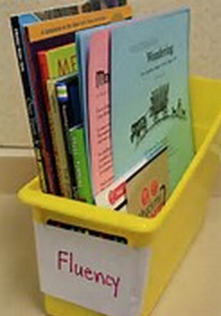
2. Repeated Readings
Select material that students can read with high accuracy (95% accuracy).
Select passages of 50-200 words
Notes:
It is important to remember that when practicing reading fluency, teachers should select reading passages that the student can already read with accuracy – that is with at least 95% accuracy. When planning repeated readings, teachers should select passages of 50-200.

Slide 23
Final Point to Remember
“Fluency is not an end in itself, but a critical gateway to comprehension. Fluent reading frees resources to process meaning.”
Notes:
In summary, reading fluency starts at the letter-sound level and moves all the way up to the connected text level. This presentation has provided teachers with ideas for working on fluency at all of these levels.
One important point to remember that the point of working on reading fluency is to aid in comprehension – the ultimate goal of reading. As the experts in the reading field state, “Fluency is not an end in itself, but a critical gateway to comprehension. Fluent reading frees resources to process meaning.” This is why it is important that FSM teachers understand the concept of reading fluency as well as provide opportunities for students to develop reading fluency at all levels.

