Slide 1
The 60-minute Daily Reading Lesson: Instruction for Phonological Awareness: Rhyming, Word Segmentation and Syllable blending/segmenting
College of Education
A Project LIFT Training Module
Module 2 – Presentation 2
Notes:
This presentation is a follow-up to presentation on understanding phonological awareness and presents information on ideas for teaching phonological awareness skills – specifically rhyming, words segmentation and syllable segmentation.
Remember that you can go at your own pace, or you can view the overview with a group of other teachers to talk about what is presented. Simply click the “Next” button to move on to the next slide.

Slide 2
What should the reading block look like?
Early Elementary
Phonemic Awareness Warm-Up (5-10)
Introduce or review sound/spelling (explicit)(10-15)
Decodable Readers (10)
Robust Vocabulary Instruction (15)
Pre-Reading Activities (5)
During Reading Activities (20)
After Reading Activities (10-15)
Notes:
Recall that phonemic awareness should be a warm up to daily reading lessons. These activities will differ by grade level as well as the skill level of students in your classroom. This presentation focuses on ideas for teaching these phonological awareness skills.

Slide 3
Effective PA Instruction
Should be explicit
Clear explanations
Modeling of tasks
Sufficient opportunities for practice
Should be systematic
Progress from easier to more difficult
Blend and segment two phoneme words before 3-4 phoneme words
Blend words with continuous sounds before blending with stop sounds, e.g., fan is easier to blend than cat
Should be fast paced
Notes:
When teaching children phonemic awareness skills, teachers should keep some key ideas about instruction in mind. First, instruction should be explicit. That means the teacher should be very clear what he/she is asking the children to do and not only tell students what they want, but show them by modeling the task. Additionally, when teachers are saying the sounds in a word or even pronouncing an entire word, they should articulate the sounds clearly and not add an /uh/ sound after pronouncing the consonant sounds, e.g., /kuh/ instead of /k/ or /tuh/ instead of /t/. This distortion of the sounds can cause many “phonemically un-aware” students to not hear the word properly. For example, if a teacher distorts the sounds of cat by saying /cuh/ /a/ /tuh/, some children could very well think the word is cuhahtuh.
It is also important to have a clear visual signal to cue children when to respond. Whether the activity is taking place in whole group or small group, most of the time children should respond in unison. Bearing this in mind, it is good practice to pause for about half a second before teachers cue the children to answer. The reason for this pause is to provide the students who find the activity more challenging an opportunity to think and respond along with the other children. We call this “think time.”
There should be sufficient opportunities for practice so children can have the opportunity to master the activity. Therefore, a sufficient number of words would be somewhere in the range of 10 words for a particular blending or segmenting activity.
Instruction should also be systematic – that means we move from easier to harder skills. Care should be taken when selecting words for phonemic awareness instruction. One rule of thumb is to have children blending and segmenting two syllable words before blending and segmenting 3 and 4 syllable words. Equally important is the idea that continuous sounds are easier for children to “hear” during the early stages of phonemic awareness instruction. Continuous sounds like, /s/ /l/ /m/ /f/ and /r/ which can be sustained without distortion are better with which to begin phonemic awareness instruction rather than stop sounds like /p/ /c/ and /b/.
Lastly, the phonemic awareness activities should be briskly paced to keep students engaged. Quick, snappy, and game-like is the rule of thumb.

Slide 4
Phonological Awareness Instruction
Should be systematic, explicit, and occur daily
Brief 7-10 minute lessons
Some practice should occur during small group instruction
Follow the sequence of the phonological awareness continuum to help students develop full range of skills starting in EC.
Notes:
Phonological awareness skills should be systematically and explicitly taught during reading/language instruction on a daily basis. This systematic and explicit teaching should incorporate the effective instructional techniques discussed earlier – modeling, guided practice with error correction, and independent practice. These phonological awareness lessons can be brief, lasting anywhere from 7-10minutes with informal practice occurring throughout the day whenever the opportunity presents itself. Additionally, some phonological awareness instruction should be provided during daily small group instruction to ensure that each student has the opportunity to hear the teacher’s production of sounds clearly and to allow the teacher to listen to each child’s production of the sounds to ensure they are correct. The content of small group instruction should be tailored to the needs of the students in the group and ought to follow the sequence of skills on the phonological awareness continuum to help students develop the full range of phonological awareness skills before the middle of first grade.

Slide 5
Continuum of Phonological Awareness Skills
Blending & Segmenting Phonemes
Blending & Segmenting Onset-Rime
More Complex Activities
Blending & Segmenting Syllables
Segmenting Sentences
Rhyming
Less Complex Activities
Chard, D. J. & Dickson, S. V. (1999) Phonological awareness: Instructional and Assessment Guidelines. Intervention in School & Clinic, 34(5), 261-270.
Notes:
You may recall from Phonological Awareness Part 1 that phonological awareness skills exist on a continuum of difficulty. This continuum of difficulty is developmental which means that teachers should introduce and develop easier skills related to sentence and words before expecting mastery of the more complex skills related to individual sounds.
Let’s show a few example activities a teacher could use to teach these skills.
Citation
Chard, D. J. & Dickson, S. V. (1999) Phonological awareness: Instructional and Assessment Guidelines. Intervention in School & Clinic, 34(5), 261-270.
Lane, H. B., Pullen, P. C., Eisele, M. R., & Jordan, L. (2002) Preventing reading failure: Phonological awareness assessment and instruction. Preventing School Failure, 46(3), 101-110.

Slide 6
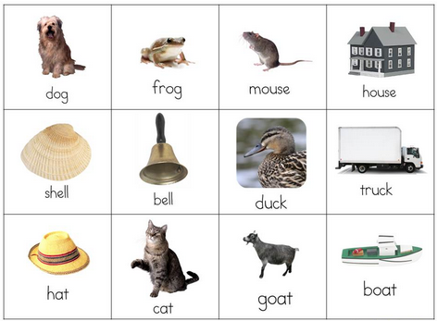
Rhyming
Notes:
One of the easiest phonological awareness tasks is working with rhyming words. There are three stages of difficulty in working with rhyme: hearing words that rhyme; discriminating rhyme, which involves picking out words that rhyme from a list of words; and producing rhyme, which involves naming words that rhyme with a given word. The following examples show the difference in these tasks.

Slide 7
Rhyming
Hearing Words That Rhyme
T: Listen to this sentence: Mom put a fish in the dish. Say it with me.
T and S: Mom put a fish in the dish.
T: Listen to these words: fish, dish. These words rhyme because they have the same sound at the
end: ish. Say the words with me.
T and S: fish, dish.
T: Great! Now I’m going to say another sentence. I will have you repeat the sentence and then tell me which two words in the sentence rhyme.
Are you ready? OK, listen carefully: We have fun in the sun. Now you say the sentence and tell me the rhyming words.
S: We have fun in the sun: fun, sun.
Notes:
The first stage of rhyming is learning to recognize words that rhyme. On the screen is a typical teaching script a teacher could use to start teaching students to recognize rhyming words. I’ll quickly go over the script. This would be repeated with different words over a period of time until students can easily find two matching words in an oral sentence.

Slide 8
Rhyming
Differentiating Rhyme
T: Listen carefully to these three words: boy, toy, car. One word doesn’t have the same ending sound. Boy and toy end the same way: oy. But car doesn’t end the same, so it doesn’t belong with boy and toy. Now I’m going to say three more words and I want you to tell me which word doesn’t belong: man, hat, fan.
C: Fan?
T: No, let’s listen again: man, hat, fan. Which one doesn’t belong?
C: Hat!
T: You’re right! Good job.
Notes:
The second stage in learning to rhyme is being able to pick out rhyming words from a group of words. This middle stage is once again demonstrated with the script you see on the screen. Let’s take a closer look. (Read script).

Slide 9
Rhyming
Producing Rhyme
T: Tell me a word that rhymes with sit.
C: Fit.
T: Yes, very good. Now tell me a word that rhymes with play.
C: Day.
T: I’m going to say a sentence and I want you to tell me the missing word. I’m looking for a rhyming word. Ready? I have a cat who’s very _____. Tell me the missing word.
C: Fat.
T: Good!
Notes:
The third and final stage of rhyming is students actually producing rhyming words themselves. Once again, a very simple script demonstrates this skill.

Slide 10
Rhyming
Many rhyming activities at:
www.phonologicalawareness.org
Example Activities:
Which One Does Not Belong?
Matching Pictures
Mystery Objects
Notes:
There are many activities that can build in these stages of rhyming. One really good resource for activities can be found at the internet site phonologicalawareness.org. The internet address is on the screen. Let’s take a brief look at three types of the rhyming activities you’ll find on this site.

Slide 11
Rhyming – Which One Does Not Belong?
Notes:
In the activity “Which one does not belong?” the teacher presents three pictures to the students. The teacher reviews the names of the pictures with the students and then asks everyone to say the names the pictures altogether. The teacher then asks which one does not belong or which one does not rhyme or sound like the others. After giving a couple seconds of think time, the teacher then asks for a group response. This is repeated with other sets of rhyming pictures.
(Demonstrate with set two).

Slide 12
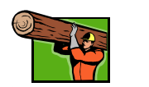
Rhyming – Matching Pictures
Notes:
This is another activity that focuses on recognizing rhyming words. In this activity a teacher places pairs of rhyming words in two different containers. Either the teacher or a student selects one word from the container and states its name. The teacher than selects a picture from the second container and states its name and then asks if the two names of the pictures rhyme, for example, dog and bed. If the answer is no, the teacher or student places the picture back in the second container and selects another picture. The picture is named, in this case log. The teacher then states the names of the pictures together, dog and log, and asks if they rhyme. If so, the two pictures are put to the side. The activity repeats with the remaining pictures.

Slide 13
Rhyming – Mystery Objects
“I’m touching an object that starts with “sp” and rhymes with moon.”
Notes:
This activity asks students to produce rhyming words – a stage 3 activity. The teacher places several familiar objects in a basket. The teacher then tells the student the object he or she is feeling using the onset plus a rhyming words. Students then guess the name of the object. In this example, a spoon is one of the items in the basket. The teacher asks the students to think of an object that starts with /sp/ and rhymes with moon. The teacher might ask the students to put their thumb up when they think they know the answer and then ask for a group response. The teacher then pulls the object out of the basket to see if they were correct in their response. This activity is then repeated with other objects.

Slide 14
Continuum of Phonological Awareness Skills
Blending & Segmenting Phonemes
Blending & Segmenting Onset-Rime
More Complex Activities
Blending & Segmenting Syllables
Segmenting Sentences
Rhyming
Less Complex Activities
Chard, D. J. & Dickson, S. V. (1999) Phonological awareness: Instructional and Assessment Guidelines. Intervention in School & Clinic, 34(5), 261-270.
Notes:
If you recall from our continuum, segmenting sentences is another type of very early phonological awareness skill. Let’s take a look at an activity demonstrating this skill.

Slide 15
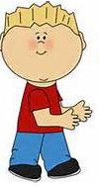
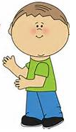
Segmenting Sentences
Example Activities:
Words are Parts
Roll Along Words
Sentence Match Up
I
am
hungry
Notes:
In the third activity, a teacher divided up a sentence by writing by creating a picture for each word in the sentence. Some words the students may already know such as I, a or the. The cards are then laid out in random order, and selected students are asked to pick up one of the pictures. The teacher then says the sentence out loud. She repeats this asking the student with each picture card to come forward and stand in a row one by one. The activity is finished when the class reads the sentence as a whole. (A dog ate a bone.)

Slide 16
Continuum of Phonological Awareness Skills
Blending & Segmenting Phonemes
Blending & Segmenting Onset-Rime
More Complex Activities
Blending & Segmenting Syllables
Segmenting Sentences
Rhyming
Less Complex Activities
Chard, D. J. & Dickson, S. V. (1999) Phonological awareness: Instructional and Assessment Guidelines. Intervention in School & Clinic, 34(5), 261-270.
Notes:
Now let’s talk about blending and segmenting. We’ll start with the easier skills of blending and segmenting syllables and then moving on to blending and segmenting phonemes. Again, here are several example activities to teach these skills.

Slide 17
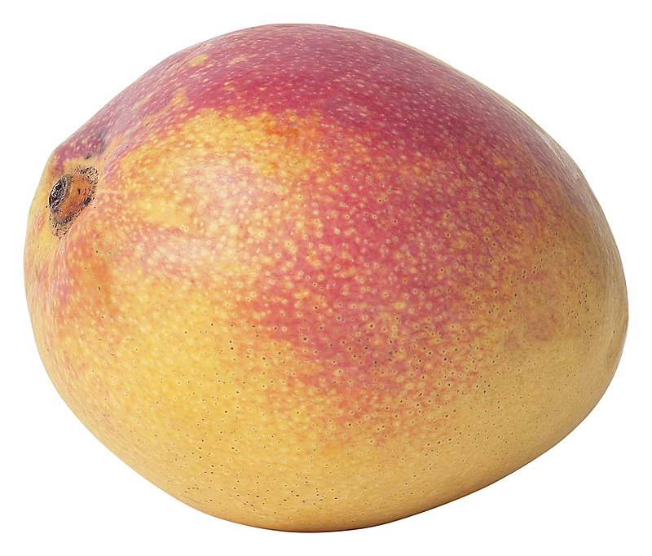
Blending and Segmenting Syllables
Blending Syllables
T: I’m going to say three parts of a word. I want you to say the whole word. Ready? Listen: man/go. What’s the word? (Think time)
S: Mango
T: Yes, mango
Repeat moving from 2- to 3- to 4 syllable words.
Notes:
Syllable blending can be as easy as the short script as seen on the slide and as discussed with clapping syllables in the previous presentation. Here the activity proceeds as follows: (follow script). The activity should start with 2 syllable words but then move quickly to 3 and 4 syllable words. For example, next a teacher might present the words taro, then mangrove, and then banana.

Slide 18
Blending/Segmenting Syllables
Segmenting Syllables
Activity: Treasure Chest
1 Syllable
2 Syllables
3 Syllables
4 Syllables
Notes:
Here is an example of a syllable segmentation activity that can be done as a large group. The teacher creates four small containers labeled 1, 2, 3 and 4 syllables. Various pictures of objectives with different numbers of syllables are prepared ahead of time. The teacher pulls out a picture and asks the students to think about the number of syllables that word has. Ask for a group response using think time of 2 seconds and a group response using signaling. If all students are correct, ask a student to place the picture in the correct box. In some students are unsure of the answer, demonstrate the number of syllables with claps. Repeat with all words.

Slide 19
A Continuum of Phonological Awareness Skills
Blending & Segmenting Phonemes
Blending & Segmenting Onset-Rime
More Complex Activities
Blending & Segmenting Syllables
Segmenting Sentences
Rhyming
Less Complex Activities
Chard, D. J. & Dickson, S. V. (1999) Phonological awareness: Instructional and Assessment Guidelines. Intervention in School & Clinic, 34(5), 261-270.
Notes:
As we climb up the continuum, we move to blending and segmenting with onset rhyme. We discussed the concept of onsite-rime in the previous presentation. Let’s take a look at one particular teaching routine that you can learn to help students with onset rime.

Slide 20
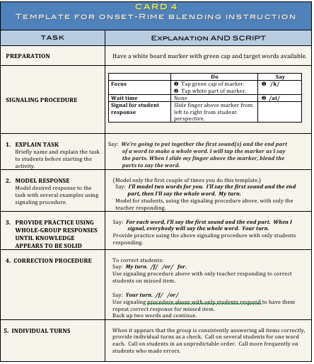
Template for Onset-Rime Blending
Card 4
Notes:
There is a template that demonstrates a routine for onset rime. This is Card 4 (Template for Onset-Rime Blending) and should be downloaded from the Module 2 website. Before we begin, let’s take a look at the component parts of each template card. There will be more templates as we move to other skills as well.
(Describe steps.)

Slide 21
Module 2, Activity 3
Card 4 Modeling and Practice
Watch the video modeling Card 4 at the following location:
When completed, practice the onset-rime teaching routine with a partner. Use the words located on Module 2, Activity 3 Handout.
When completed, move on to Module 2, Presentation 3.
Notes:
Let’s take a look at Onset-Rime blending in action. Stop the presentation and watch the video demonstrating onsite rime. Once you have completed this activity, please practice this teaching routine. Take out Module 2, Activity 3 and complete the activity as written. When completed you are ready to move on to the next presentation Module 2, Presentation 3 that includes strategies for blending and segmenting phonemes.

