Slide 1
The 60-minute Daily Reading Lesson: Instruction for Phonological Awareness: blending and segmenting phonemes
College of Education
A Project LIFT Training Module
Module 2 – Presentation 2
Notes:
This presentation is a follow-up to presentation on understanding phonological awareness and presents information on ideas for teaching phonological awareness skills – focusing this time on individual phoneme blending and segmenting.
Remember that you can go at your own pace, or you can view the overview with a group of other teachers to talk about what is presented. Simply click the “Next” button to move on to the next slide.

Slide 2
A Continuum of Phonological Awareness Skills
Blending & Segmenting Phonemes
Blending & Segmenting Onset-Rime
More Complex Activities
Blending & Segmenting Syllables
Segmenting Sentences
Rhyming
Less Complex Activities
Chard, D. J. & Dickson, S. V. (1999) Phonological awareness: Instructional and Assessment Guidelines. Intervention in School & Clinic, 34(5), 261-270.
Notes:
Phoneme blending and particularly phoneme segmentation have been identified as key skills in the realm of phonological awareness and most directly connected to early reading and spelling skills. These skills can be taught and practiced in many ways. Let’s take a look at several of them.

Slide 3
Sample Script for Oral Blending Explain, Model, Respond, and Assess
Explain
Model
Explain
T: “We are going to play a word game. I‘ll say a word slowly, then you say the word fast.
Model
Listen… aaaaammmm. Now I will say the word fast. (am). Now it’s your turn. Listen carefully to the sounds say, then you say the word fast. I will move my hand to signal for you to answer.”
Respond
Assess
Notes:
First we’ll talk about an informal instructional routine for oral blending. The key points of the routine are: Explain, Model, Respond, and Assess. Remember, the activities presented should be presented in such a way that students feel it is a game. The activities should be quickly paced and fun.
The first step is to introduce the task by explaining what to do and providing a model. So, here the script reads: “We are going to play a word game. I‘ll say a word slowly, then you say the word fast.”
Then the teacher provides modeling. “Listen… aaaaammmm. Now I will say the word fast. (am). (on) (run). Now it’s your turn. Listen carefully to the sounds I say, then you say the word fast. I will move my hand to signal for you to answer.” Providing a number of examples may be necessary.
Notice that the sounds are stretched out at first using continuous sounds. After the children have had some practice with the oral blending routine using continuous sounds, then you can move to stop sounds like /b/ and /p/ which cannot be stretched. It is important to have a non-verbal signal to cue the children to respond in unison.
Reference: Carnine, D. W. & Silbert, J. (2005). Teaching struggling and at risk readers: a direct instruction approach. New York: Prentice Hall.

Slide 4
Routine for Oral Blending Explain, Model, Respond, and Assess
Respond
T: “iiiiiifffff. What word?”
(Provide signal, pause for a split second to give time for children to think and respond.)
S: Respond in unison by saying the word, if
T: Repeats steps this step with several more words starting first with continuous sounds such as: Sam, fun, rain and then moving to words starting with stop sounds such as: gum, pot, ten
(Teacher repeats words until students can respond correctly to all the words, making no errors.
Assess
T: Gives individual turns to several students to assess mastery with the skill.
Notes:
We now move to having children practice the skill. The cue will be saying the slowly and asking “What word?” For example, on the slide you see the cue: “iiiiffff. What word?” The teacher should pause for a split second to give time for children to think and provide a signal for the students to respond.)
New words are introduced following the same instructional routine. It is important to minimize teacher talk in any direct instruction lesson once children understand the task.
The last step assures that children are successfully accomplishing the task. The assess calls for the teacher to do some informal assessment of individual students by giving individual turns to selected students.
In summary, you can print off or copy this routine to work on phoneme blending in your classroom. Just follow the steps of Explain, Model, Respond, and Assess.
Reference: Carnine, D. W. & Silbert, J. (2005). Teaching struggling and at risk readers: a direct instruction approach. New York: Prentice Hall.

Slide 5
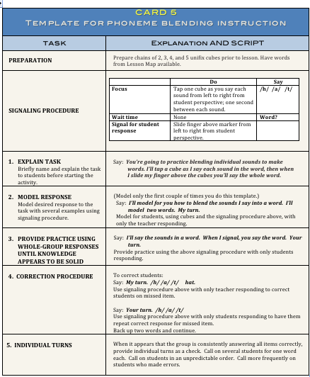
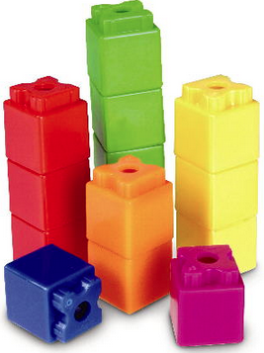
Template for Oral Blending – Card 5
Notes:
Another routine that can be used to practice blending can be found on the teaching template for Card 5 – Phoneme Segmentation Instruction. If available, take out this card now and follow along as we go over each of the steps in this routine.
In order to complete this activity, you will need to prepare chain of unifix cubes for 2- 3- and 4-phoneme words along with a list of words for segmenting. Unifix cubes are simply cubes that attach together and are sometimes used for math instruction. If you do not have unifix cubes, simply cut out small squares of different color construction paper and tape them together on the back. To get you started, you will find a list of 2-, 3- and 4- phoneme words in the Handout entitled “HO 1 – Phoneme Blending” on the module home page.
Basically, the routine is as follows: The teacher will tap one cube as he or she says each sound from left to right from the student perspective. In other words, since the teacher will be facing the students you want to ensure your movement is from left to right as the students are seeing you tap the cubes. There should be about one second between each sound. After you have said the last sound, ask “Word?” As the students respond, slide your finger above the blocks from left to right, again from the student perspective.
First, the teacher explains the task as follows: You’re going to practice blending individual sounds to make words. I’ll tap a cube as I say each sound in the word, then when I slide my finger above the cubes you’ll say the whole word. Next the teacher models the task by saying the following: I’ll model for you how to blend the sounds I say into a word. I’ll model two words. My turn.” /s/ /i/ /t/ /sit/. /r/ /u/ /n/ /run/.
Then students practice the skill. The teacher starts this process by stating, “Il’l say the sounds in word. When I signal, you say the word, Your turn.” The teacher then begins the routine using approximately 10-12 words.
If the teacher hears a student make an error, the correction procedures is found on the card. Essentially, the teacher models the word. For example, if one of the students was incorrect on the word “hat,” the teacher “My turn. /h//a//t/ hat. Your turn.” and the students re-practice the word.
It is a good idea to provide several individual turns at the end of the session just to check on individual mastery of the skill. As noted, call on students in an unpredictable order and more frequently on students who have made errors during the session.

Slide 6
Module 2, Activity 4
Card 5 Modeling and Practice
Watch the video modeling Card 5.
When completed, practice the Phoneme Blending teaching routine with a partner. Use the words located on Module 2, Activity 4 Handout.
When completed, return to the presentation.
Notes:
Let’s take a look at the Phoneme Blending Instructional routine in action. Stop the presentation and watch the video demonstrating phoneme blending. Once you have completed this activity, please practice this teaching routine. Take out Module 2, Activity 4 and complete the activity as written.

Slide 7
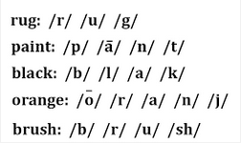
Phoneme Segmentation
Segmenting: Given a whole word, a student separates the word into its individual phonemes and says each sound, e.g., What are the sounds in rug? How many sounds?
Notes:
The last skill we’ll discuss in this model is strategies for teaching phoneme segmentation. Remember that phoneme segmentation involves asking the student to identify individual sounds or phonemes within words. This is the opposite of phoneme blending and is a more difficult skill.

Slide 8
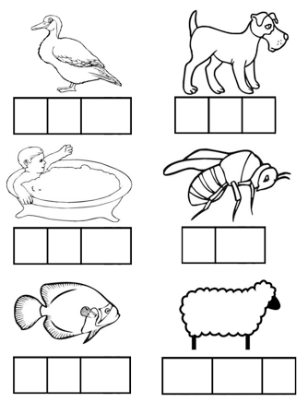
Phonemic Awareness Instruction
Elkonin Boxes
= pig
Notes:
There are many different activities that can be used to model and teach phoneme segmentation. One example is using what are called Elkonin boxes. The Elkonin box strategy simply uses boxes drawn as squares on a piece of paper chalkboard, with one box representing each sound or phoneme. The name “Elkonin” is simply the last name of a researcher who first came up with the idea of boxes representing sounds.
You can use Elkonin boxes in a number of ways. First, you can create individual sheets with a number of pictures and square below those pictures for the students to segment phonemes. For example, on the screen you will see such a sheet. For your convenience, Handout 2 contains several sheets of pictures with Elkonin boxes. Otherwise, the teacher can simply ask students to draw boxes or squares on a sheet of paper. You can also prepare these boxes ahead of time. The last page of Handout 5 has rows of Elkonin boxes a teacher can cut apart for student use and simply have pictures for the teacher to use in front of the class.
The procedure would be as follows:
First, pronounce a target word slowly. Ask the students to repeat the word by asking, “What word?” Then, direct the student to slide one circle, cube or counter into each cell as the repeat the word slowly. The teacher can then ask how many sounds they heard in the the word and to say the sounds together with you and then say the word fast once again. For example let’s listen to an example using the word pig. “Listen, pig. What word? /pig/ Now say the word slowly and move one chip for each sound you each into the box.” After giving some wait time for the students to individually complete the task, say: “How many sounds did you hear? Say the sounds with me. /p/ /i/ /g/. Now say the word fast. /Pig/.”
Then continue to work with other words.

Slide 9
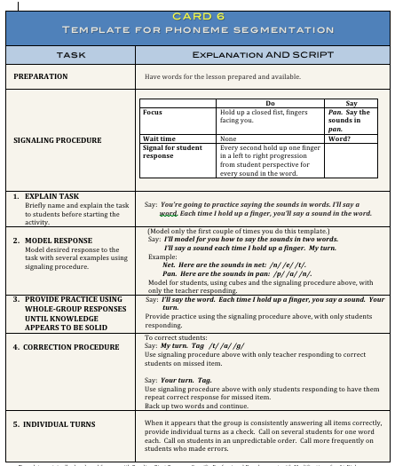
Phoneme Segmentation: Card 6
Notes:
Another strategy to work on phoneme segmentation is using the routine demonstrated in Template Card #6 – Phoneme Segmentation. Take out this card now and follow along as we go over each of the steps in this routine.
In order to complete this activity, you simply need a list of 2-, 3- and 4- phoneme word. Again, you can use words in the Handout entitled “Phoneme Segmentation Words” to get started and/or create a word list of your own.
Basically, the routine is as follows: The teacher holds up a closed fist with their fingers facing toward them as shown on the screen if using the left hand. At the same time, the teach says a word and asks the the students to say the sounds in the word. You will notice the script uses the following example: “Pan. Say the sounds in pan.” The teacher then asks for the entire word. As the student responds, every second the teacher holds up one finger in a left to right progression from the student perspective for every sounds in the word.
The teacher explains the task as follows: You’re going to practice saying the sounds in words. I’ll say a word. Each time I hold up a finger, you’ll say a sound in the word. Next the teacher models the task by saying the following: I’ll model for you how to say the sounds in two words. I’ll say a sound each time I hold up a finger. My turn. Net. Here are the sounds in net: /n/ /e/ /t/.
Pan. Here are the sounds in pan: /p/ /a/ /n/.
Then students practice the skill. The teacher starts this process by stating, “I’ll say the word. Each time I hold up a finger, you say a sound. Your turn.” The teacher then begins the routine using approximately 10-12 words.
Once again, if the teacher hears a student make an error, the correction procedure is found on the card. Essentially, the teacher models the word. For example, if one of the students was incorrect on the word “hat,” the teacher would say “My turn. Tag /t/ /a/ /g/. Your turn.” and the students re-practice the word.
It is a good idea to provide several individual turns at the end of the session just to check on individual mastery of the skill. Remember to, call on students in an unpredictable order and more frequently on students who have made errors during the session.

Slide 10
Module 2, Activity 5
Card 6 Modeling and Practice
Watch the video modeling Card 6.
When completed, practice the Phoneme Blending teaching routine with a partner. Use the words located on Module 2, Activity 5 Handout.
When completed, return to the presentation.
Notes:
Let’s take a look at the Phoneme Blending Instructional routine in action. Stop the presentation and watch the video demonstrating phoneme blending. Once you have completed this activity, please practice this teaching routine. Take out Module 2, Activity 4 and complete the activity as written.

Slide 11
Phonemic Awareness Instruction
In Summary. . .
Practiced a number of skills
Preparation is essential
More ideas:
www.phonologicalawareness.org
http://www.readingresource.net/phonemicawarenessactivities.html
http://www.fcrr.org/for-educators/sca_k-1_rev.asp
Notes:
In summary, we have provided examples of teaching strategies for a number of phonological awareness skills ranging from rhyming to phoneme segmentation. These were just a sample of strategies, but ones that can be used over and over again in classrooms with a variety of different words. The key for using all of these activities is that you must practice prepare for them. Have the activities as well as the word lists ready to go. Otherwise, you will not be able to use a perky, fast pace to keep your students interested and enthusiastic.
For many more exciting and fun activities to teach phonological awareness skills, three website are listed on your screen. Each has a large number of activities for developing different phonological awareness skills at different grade levels. Please take some time to look these over and select a few to use in your classroom in addition to the strategies already presented.

Slide 12
Next Steps
Move on to Module 3 – the Alphabetic Principle
Before doing so, prepare for Module 3 by completing Activity 6: Put Reading First - Phonics
Notes:
If you have completed all of the activities in the module, you are ready to move onto Module 3 which focuses on phonics skills. In order to prepare for this module, please take out Module 3, Activity 6 and complete the activity as shown on the document. This activity involves reading the phonics section of “Put Reading First.” When you have finished this activity, please move on to Module 3.

