Slide 1
Oral Language Development, Early Reading skills, and English Language Learners
College of Education
A Project LIFT Training Module
Oral Language Development – Part 1
Notes:
This is the first presentation on oral language development. The module focuses on the connection between oral language development and other literacy skills such as reading and writing.

Slide 2
Goals of the Module
Understand the relationship between oral language development and reading and writing
Understand the concepts of “social language” and “academic” language.
Part 2: Strategies for Oral Language Development

Slide 3
Defining Language
Language =
A code made up of rules that include
What words mean,
How to make words,
How to put them together, and
What word combinations are best in what situations.
Speech is the oral form of language.
www.asha.org/public/speech/development

Slide 4
Research Conclusions: Oral Language Development
Children’s speaking and listening skills lead the way for their reading and writing skills, and together these language skills are the primary tools of the mind for all future learning.
(Roskos, et al., 2009)
Notes:
Roskos, K.A., Tabors, P.O., Lenhart, L.A. (2009). Oral Language and Early Literacy in Preschool (2nd ed.), United States of America: International Reading Association.

Slide 5
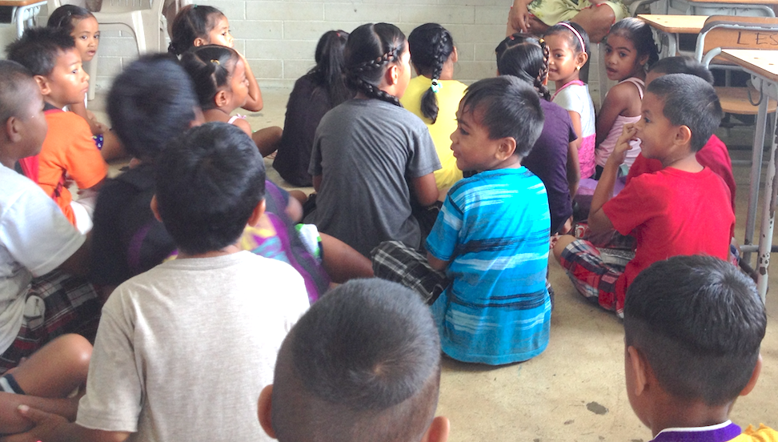
Research Conclusions: Oral Language Development
Proficiency in oral language provides children with a vital tool for thought. Without fluent and structured oral language, children will find it very difficult to think.
(Brunner, 1983)
Notes:
Bruner, J. (1983). Child’s talk: Learning to use language. New York: WW Norton & Co.

Slide 6
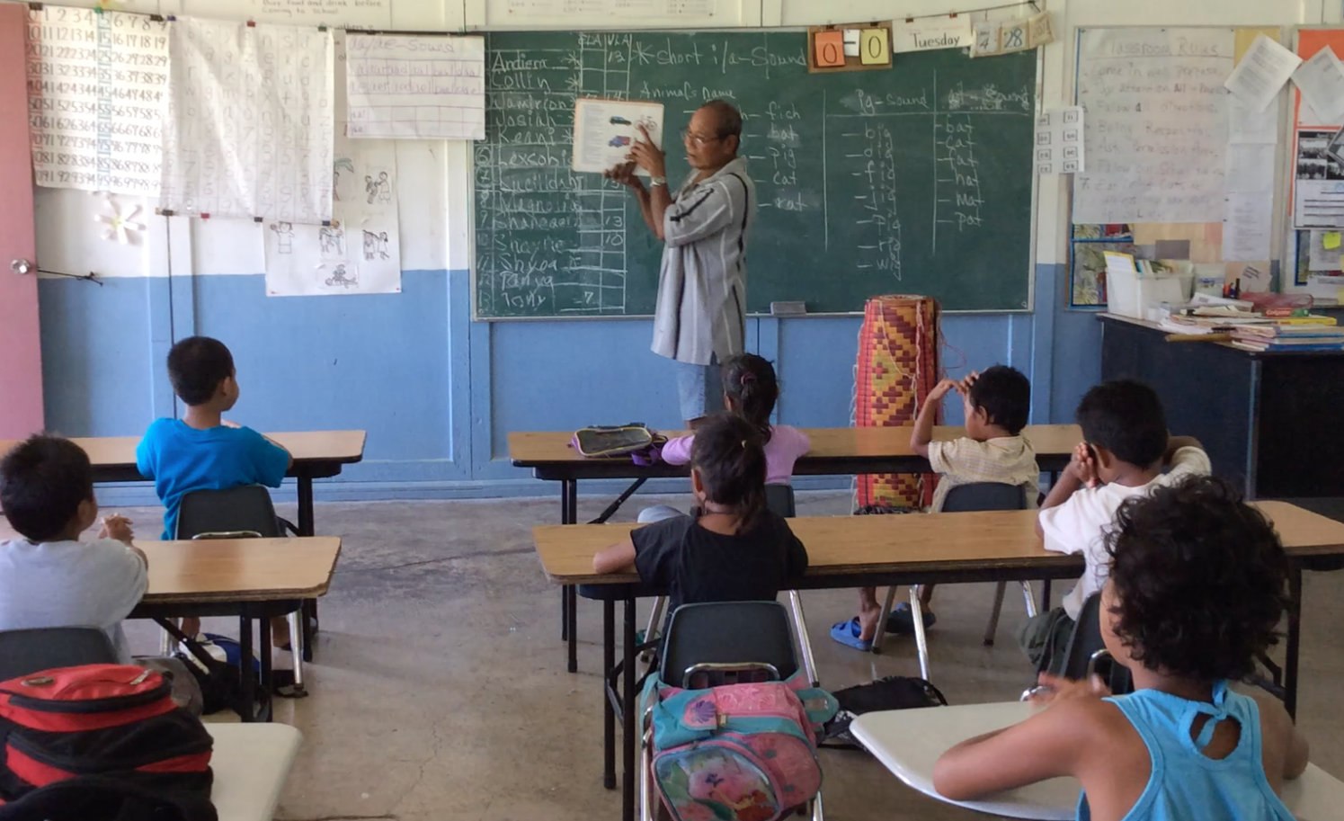
Research Conclusions: Oral Language Development
“Schools have to be aware of the language needs children have and address these by integrating language development into all areas of the school day.
(Roskos, et al., 2009)
Notes:
Roskos, K.A., Tabors, P.O., Lenhart, L.A. (2009). Oral Language and Early Literacy in Preschool (2nd ed.), United States of America: International Reading Association.
Kirkland, L.D. & Patterson, J. (2005). Developing Oral Language in Primary Classrooms. Early Childhood Education Journal, 32: 6, 391-395.

Slide 7
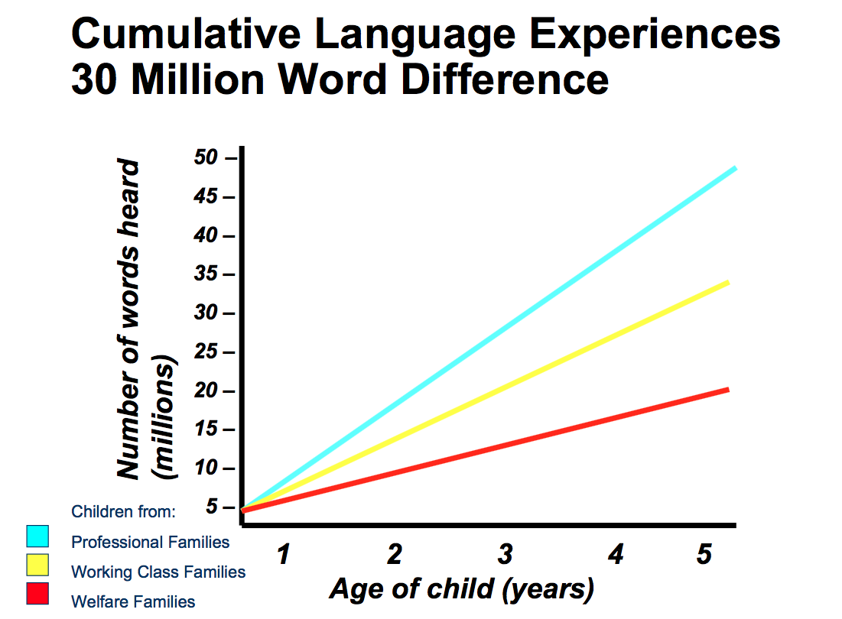

Slide 8
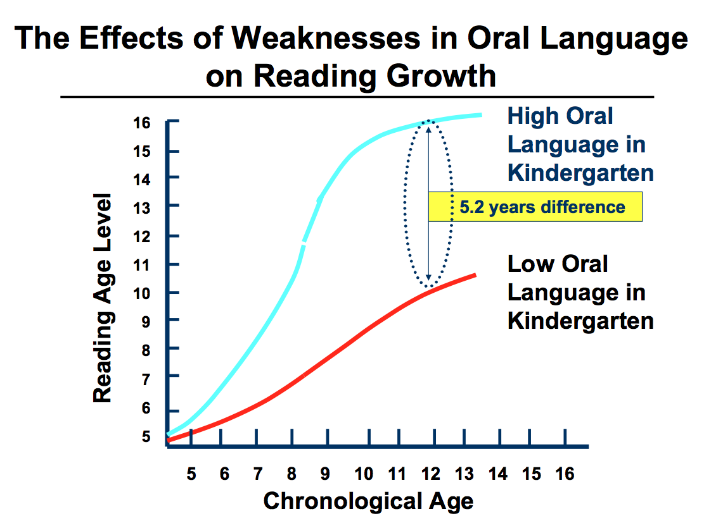

Slide 10
Academic Language and Social Language: What’s the Difference?
Educators describe language used by English Learners as “social language” and “academic language”
There is a difference between the two that teachers should be aware of.
Let’s learn a little more about the similarities and differences between academic language and social language.

Slide 11
Oral Language Module, Activity 1
Please watch the video entitled “Building Academic Language” within this module. When done, complete the worksheet Oral Language Module, Activity 1.
Discuss your answers with a colleague.

Slide 12
Academic Language and Social Language
Social Language
Day ­to ­day language needed to interact socially with other people.
English language learners (ELLs) use these skills when they are on the playground, in the lunch room, on the school bus, playing sports and talking on the telephone.
Everyday conversations
Notes:
These language skills usually develop within six months to two years after arrival in the U.S.

Slide 13
Academic Language and Social Language
Problems arise when teachers and administrators think that a child is proficient in a language when they demonstrate good social English.
But - Just because the child can speak on the playground, talk to peers, and use everyday English does not mean that they are up to speed in academic English.

Slide 14
Academic Language
Is more demanding and complex than social English
Language used in academic settings and for academic purposes to help students acquire and use knowledge (Anstrom, et al., 2010)
Notes:
This includes listening, speaking, reading, and writing about subject area content material. This level of language learning is essential for students to succeed in school. Students need time and support to become proficient in academic areas. This usually takes from five to seven years. Recent research (Thomas & Collier, 1995) has shown that if a child has no prior schooling or has no support in native language development, it may take seven to ten years for ELLs to catch up to their peers.
Academic language acquisition isn't just the understanding of content area vocabulary. It includes skills such as comparing, classifying, synthesizing, evaluating, and inferring. Academic language tasks are context reduced. Information is read from a textbook or presented by the teacher.

Slide 15
Academic Language
Academic language is the oral and written language that students need in order to:
Understand (read, listen, think)
Communicate (listen, speak, write, connect)
Perform (think, read, write, listen, speak, create)
Academic Language is necessary to participate in the content:
Think
Question
Talk
Learn
Notes:
If we think about academic language as the oral and written language that students need in order to understand (read, listen, think), communicate (listen, speak, write, connect), and perform (think, read, write, listen, speak, create) in the specific subject areas taught in schools, we realize that it is complex and complicated. We are teaching our students ways of participating in the content—how to think about it, how to question or talk about it, how to learn it.

Slide 16
Academic Language and Social Language
Take-away:
All FSM teachers must build academic language instruction into their daily schedule
This is ALL teachers – not just teachers that teach language arts.

Slide 17
Oral Language Module, Activity 2
With a partner or small group, summarize this module by answering the following questions:
Define social language. What are the main goals of social language?
Define academic language. What are some of the goals of academic language?
What is the caution in this Part 1 module about social and academic language?

Slide 18
End of Part 1
Please move on to Part 2 of the Oral Language Development Module
Part 2 will describe research on how to develop English oral language.
We will also discuss particular strategies for developing English oral language with FSM students.

