Slide 1


Reading Comprehension instruction
CORE - Center at Oregon for
Research in Education
A Project LIFT Training Module
Module 6 – Part 2
Notes:
This is the Module 6, Part 1 presentation on development text comprehension instruction.

Slide 2

Principles of Comprehension Instruction
What classroom practices will support students’ reading comprehension?
Notes:
Part 2 of Module 6 focuses on classroom practices, including strategies, that teachers can put in place in order to improve reading comprehension. We will start broadly and then move to move specific strategies.

Slide 3

Principles of Comprehension Instruction
Ensure Fluent Reading
Develop Vocabulary Knowledge
Develop Strategic Processing
  Cognitive Strategy Instruction
  Developing Metacognition
  Understanding Text Structures
Build Background Knowledge
Provide Opportunities for Extended Discussion of Text in teacher-led and peer-led formats
Notes:
As a reminder, let’s review some of the key understandings presented in Part 1 that teachers must consider when considering ways of improving overall comprehension skills. Those areas listed on the screen all make important contributions to a student being able to read with comprehension.

Slide 4

Fluent Reading and Its Contribution to Strong Comprehension
Fluency - A Deep Construct Definition
  “Efficient, effective word recognition skills that permit a reader to construct the meaning of text. Fluency is manifested in accurate, rapid, expressive oral reading and is applied during, and makes possible, reading comprehension.”
Notes:
Remember that fluency includes the features of fluency: speed, accuracy, and prosody. Fluency difficulties are always something that needs to be ruled out as a primary cause of comprehension problems, particularly at the upper elementary grades when teachers sometimes assume their students can read accurately and fluently.

Slide 5
Fluent Reading and Its Contribution to Reading Comprehension
Instructional Considerations:
  Is oral reading fluency at the expected level?
    Look at both reading rate as well as reading accuracy.
    Calculate rate (wpm)
    Calculate accuracy (percentage of words read correctly)
Notes:
Asking a student to read grade level material and then analyzing the accuracy and rate can be used to check students’ fluency, If the student is below the expected fluency rate and/or makes many errors, then the teacher must work with the student on fluency development. That does not mean comprehension instruction should stop. Rather, comprehension instruction may need to take place with easier reading material, while at the same time working on fluency development.

Slide 6
Principles of Comprehension Instruction
Fluent Reading
Strategic Processing
  Cognitive Strategy Instruction
  Developing Metacognition
  Understanding Text Structures
Opportunities for Extended Discussion of Text in Teacher-Lead and Peer-Mediated Formats
Vocabulary Knowledge
Notes:
Spending time every day working on vocabulary development will also aide in improving comprehension.

Slide 7
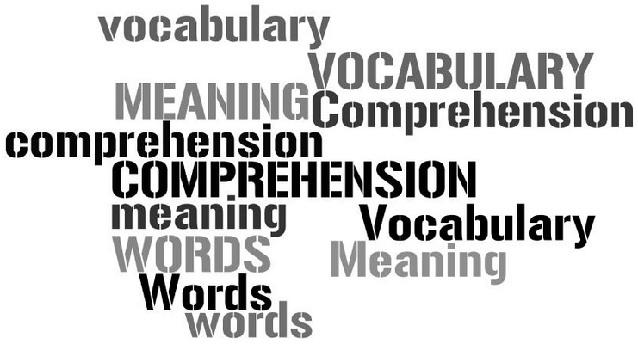
One of the most persistent findings in reading research is the extent to which students’ vocabulary knowledge relates to their reading comprehension.
Vocabulary Instruction
Notes:
Recall from the previous module that vocabulary plays a significant role in a student’s overall comprehension skills. In fact, one of the most persistent findings in reading research is the extent to which students’ vocabulary knowledge relates to their reading comprehension. (Research from (Anderson & Freebody, 1981; Anderson & Nagy, 1991; Baumann, Kame’enui & Ash, 2003; Becker, 1977; and others).
All teachers, whether a reading teacher, science teacher, math teacher, or a teacher of other subjects, must set aside time to teach vocabulary to their students on an everyday basis. This cannot be overemphasized. For specific strategies for building vocabulary, please see the module specifically devoted to vocabulary development. Developing vocabulary of students in all grades and subject areas can and will positively impact a student’s overall comprehension skills.

Slide 8
Principles of Comprehension Instruction
Fluent Reading
Vocabulary Knowledge
Strategic Processing
  Cognitive Strategy Instruction
  Developing Metacognition
  Understanding Text Structures
Build Background Knowledge
Provide Opportunities for Extended Discussion of Text in teacher-led and peer-led formats
Notes:
Moving on, we will now spend quite a bit of time discussing specific comprehension strategies that students can be taught to use in order to help them comprehend text.

Slide 9
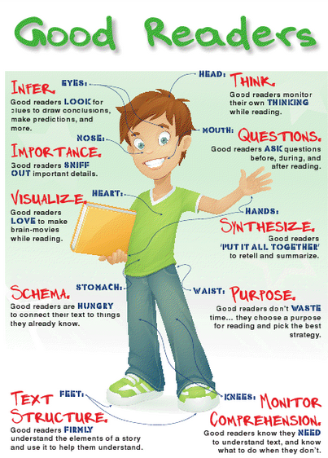
Cognitive Strategy Instruction
Comprehension Strategies:
  Conscious plans or sets of steps that good readers use to make sense of text.
  Comprehension strategy instruction helps students become purposeful, active readers who are in control of their own reading comprehension.
Notes:
We will now spend quite a bit of time discussing specific comprehension strategies that students can be taught to use in order to help them comprehend text. In simple terms, comprehension strategies are conscious plans or sets of steps that good readers use to make sense of text. Good readers tend to do these things without a great deal of instruction. For many students, however, using these strategies is not something they do on their own and therefore need instruction on how and when to use them. As noted, comprehension strategy instruction helps students become purposeful, active readers who are in control of their own reading comprehension.
A number of these strategies are on the right hand of the slide. Take a minute to look at these strategies before we learn more about them.

Slide 10
Comprehension Strategies with Research Evidence
Reader Strategies:
  Comprehension Monitoring
  Story Structure
  Question Generation
  Summarization
  (Multiple Strategies)
Teacher Strategies:
  Graphic Organizers
  Question Answering
  Cooperative Learning
Notes:
The National Reading Panel identified seven different strategies that research indicates helps students better comprehend text. These can be divided up into two groups: Reader Strategies and Teacher Strategies. Reader strategies are those strategies taught to taught with the goal of students using these strategies independently when needed. These include comprehension monitoring, being able to recognize different text structures, generating questions as they read, and being able to summarize text they have just read. In addition, research indicates that students do make gains in comprehension when being able to use these strategies in combination or using multiple strategies.
Teacher strategies, on the other hand, are strategies teachers can use during instruction to assist students with comprehension. These include the use of graphic organizers, strategic questioning, and setting up groups for cooperative learning.
Let’s take a closer look at some of these strategies.

Slide 11
How Should Strategies Be Taught?
Comprehension Strategies with Research Evidence
Teachers demonstrate explicit steps and strategies to students explaining what the strategy is and what is its purpose.
Teachers model multiple examples of how to apply the strategy using a “thinking aloud” procedure while interacting with actual text.
Teachers provide students with extensive opportunities to practice strategies and offer high-quality feedback.
Teachers structure ample review and opportunities for learning how and when to use strategies, within the context of reading actual text.
Notes:
Before discussing these strategies, however, it should be noted that teachers cannot simply ask students to use the strategies. They must be taught directly to students just as you would other reading skills such as sounds, blending, and word reading. This instruction does not happen in one setting. Rather, teachers work on directly teaching the strategies multiple times until students can start using the strategies more independently.
First, with all strategy instruction, teachers should demonstrate the explicit steps within strategies to students explaining what the strategy is and what its purpose is.
Second, teachers should model with multiple examples of how to apply the strategy using a “thinking aloud” procedure while interacting with actual text. Thinking aloud means that you demonstrate by telling the students what you are thinking as you use the strategy.
Next, teachers should provide students with extensive opportunities to practice strategies and offer high-quality feedback.
And, finally, teachers must structure ample review and opportunities for learning how and when to use strategies, within the context of reading actual text.

Slide 12
Comprehension Monitoring
Before Reading
During Reading
After Reading
• M e t a c o g n I t I o n •
The Executive Control Function Used Before, During and After Reading
Notes:
Let’s move on to our first strategy which involves comprehension monitoring. Many comprehension strategies embody the concept of something called metacognition. Metacognition can be defined as “thinking about thinking.” It is the “bigger picture” of comprehension monitoring. Good readers use metacognitive strategies to think about and have control over their reading.
There are certain activities a student can think about before, during and after reading to improve their comprehension.

Slide 13
Comprehension Monitoring
Before Reading
During Reading
After Reading
• M e t a c o g n I t I o n •
Preview the text.
Comprehension Monitoring
Check understanding of what has been read.
Notes:
So, a general framework to teach comprehension strategies would be to think about what strategies to teach children to use before they read, while they are reading, and after they are done reading. We will take that approach right now. However, be aware that many of these strategies can be used at multiple times, including before, during, and after reading.
As far as comprehension monitoring, our first strategy, before reading a piece of writing, students should taught to preview the text. Previewing the text means looking at the title, the front cover, back cover, and perhaps even chapter headings if in a higher grade. After previewing, students can have short discussions about what they noticed, discuss what they already know about the topic, and even make predictions about what the reading may be about.
After reading, students can then think about and/or discuss whether their predictions came true and check their understanding of what they have just read. Most comprehension monitoring activities, however, take place while students are reading. We’ll talk about this next.

Slide 14
Comprehension Monitoring
Definition: Teaching readers to become aware of how well they understand what they are reading.
Teaches students to notice:
  When they do not understand
  Identify what they do not understand
  Use appropriate “fix up” strategies to resolve problems
Notes:
While reading, good readers are constantly checking their understanding of what has been read. This is called comprehension monitoring. A good comprehension strategy is simply teaching students to constantly check to see if they understand. They need to learn to recognize when they don’t understand, identify what it is that they don’t understand, and then use what we call “fix up strategies” to resolve their lack of understanding.

Slide 15
Comprehension Monitoring
Think-Aloud: Teachers verbalizing or saying out loud what they are thinking as they model a strategy.
Steps:
  Select a piece of text the students will be reading or similar text.
  Explain what the objectives of the lesson:
    To teach students how to become aware of their own understanding during reading
    To teach students to monitor their comprehension and to stop and think about their reading and understanding
    To teach students to use fix-up strategies to help their fix the meaning when it breaks down.
Notes:
A good tool that teachers can use to teach this strategy is called a teacher “Think Aloud.” A think-aloud involves teachers verbalizing or saying out loud what they are thinking as they model a strategy. These include describing things they’re doing as they read to monitor their comprehension. The purpose of the think-aloud strategy is to model for students how skilled readers make meaning from a text.
Take a minute now to read the first three steps in doing a read think-aloud. The lesson starts with explaining the objectives of the lesson:
To teach students how to become aware of their own understanding during reading
To teach students to monitor their comprehension and to stop and think about their reading and understanding
To learn to use fix-up strategies to help their fix the meaning when it breaks down.

Slide 16
Comprehension Monitoring
Steps:
  Say: “Today I am going to read . . . As I read, I want to show you what I think about when I am reading. If something does not make sense or is confusing to me, I will stop and try to fix the problem. While I am reading, if something is confusing to me, I will stop and talk out loud to show you how I monitor my comprehension. Watch what I do as I read.”
  Read the text modeling thinking aloud demonstrating:
  when you do not understand
  identifying what you do not understand
  using appropriate “fix up” strategies to resolve problems
Notes:
Then say the following to the students: “Today I am going to read . . . As I read, I want to show you what I think about when I am reading. If something does not make sense or is confusing to me, I will stop and try to fix the problem. While I am reading, if something is confusing to me, I will stop and talk out loud to show you how I monitor my comprehension. Watch what I do as I read.”
Then Read the text modeling thinking aloud demonstrating:
when you do not understand
identifying what you do not understand
using appropriate “fix up” strategies to resolve problems

Slide 17
Comprehension Monitoring
Fix-Up Strategies to Teach:
  Reread at a slower rate
    “I didn’t quite understand what that sentence meant. I think I’ll reread it again only more slowly and think about what it means.”
  Look back through the text
    “I know the story has mentioned Chester before, but I can’t remember much about him. Maybe if I go back and reread a couple of pages I’ll remember who he is.”
  Look forward through the text
    “I’m confused about why Lilly’s friends would disguise their voices if they are her friends…I bet if I keep reading it will help explain why they did it.”
Notes:
On the slide are three example fix-up strategies teachers can teach students to use when they “get stuck” with understanding the text. These include stopping and rereading the text at a slower rate, stopping and looking back through the text, and stopping, thinking, and deciding to look forward through the text. Take a moment to look at the example scripts of how this might sound for each of these fix-up strategies.

Slide 18

Module 6, Activity 2
For a demonstration of this strategy, please stop the presentation and complete Module 6, Activity 2.
Download Module 6, Activity 2.
You will be watching the video “Think Aloud” located within Module 6 materials.
This activity will take at least one hour to complete.

Slide 19
Question Generation
Before Reading
During Reading
After Reading
• M e t a c o g n I t I o n • Comprehension Monitoring
Students Generate Questions
Notes:
A general framework to teach comprehension strategies would be to think about what strategies to teach children to use before they read, while they are reading, and after they are reading. We will take that approach right now. However, be aware that many of these strategies can be used at multiple times, including before, during, and after reading.

Slide 20

Question Generation
Definition: Asking students to/teaching students to generate questions during reading.
National Reading Panel:
  The strongest scientific evidence for reading comprehension strategies was found for the effectiveness of asking readers to generate questions during reading.
Notes:
The definition of question generation is fairly straightforward. It involves teaching students to ask question about the text – particularly while they are reading. Teaching students to ask their own questions improves their active processing of text and so improves comprehension.
By generating questions, students become aware of whether they can answer the questions and, thus, whether they understanding what they are reading. Out of all the comprehension strategies studies by the National Reading Panel, question generation had the highest effect on students’ comprehension. Therefore, it is important that teachers add this strategy to their “bag of tricks” for increasing reading comprehension of their students.

Slide 21
Why is Question Generation Important?
By asking questions, students actively engage and interact with the text.
Students become aware of their ability to answer their questions and have a deeper understanding of the text.
Students ask and answer their own questions rather than only answering questions asked by the teacher. Responsibility shifts for learning from the teacher to the student.
Notes:
Question generation is important for a number of reasons:
By asking questions, students actively engage and interact with the text. Students become aware of their ability to answer their questions and ultimately have a deeper understanding of the text. And, finally, when using the question generation strategy, students pose and answer their own questions rather than only answering questions posed by the teacher. This then shifts responsibility for learning from the teacher to the student.

Slide 22
Question Generation Prerequisites
Finding Important Ideas
Turning important ideas into integrative questions
Turning Statements into Questions
Question Generation
Answering an Integrative Question
Answering Questions
Notes:
Teaching question generation may not be as easy as it appears, especially for students who are learning English as a second language because of the language skills needed during the question generation strategy of how to turn idea statements into questions. A number of prerequisite skills are needed in order to use the question generation strategy and will most likely need to be taught to your students. Let’s briefly look at each of these.

Slide 23
Question Generation Prerequisites
Answering Questions
Question Starter | Generalized Answer
Who | Person or people
What | Object, description, or process
Where | Location
When | Time
Why | Reason or Explanation
How | Quantity, Process, or Description
Students need to know how to ask and then answer questions.
Matching question starts to generalized answers helps students answer questions
Notes:
The use of prompt can help students generation questions. The prompt listed on the screen can be made into a poster and put up in the classroom in order to help students ask as well as answer questions. Teaching students to match question starters to generalized answers as seen on the table can help students ask as well as answer questions. Questions with who, where and when tend to be easier for students because the answers are not difficult. How and why questions are more complex and can be particularly challenging for students to answer correctly. For more ideas on teaching students about question starters, please read pages 20-27 of the resource Question Generation from the Effective Instructional Strategies Series found within the Module 6 materials.

Slide 24
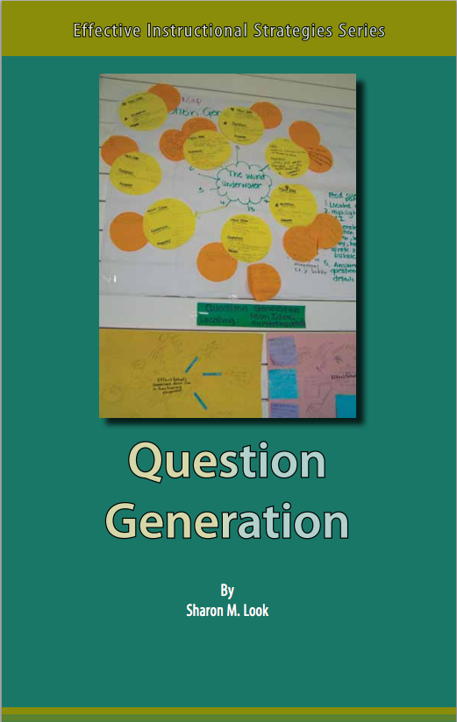
Question Generation Prerequisites
Turning Statements into Questions
For ideas on how to teach this skill, read and complete the activities on pages 28-31:
Provide direct instruction on having students turn a statement into a question.
Requires instruction on using the correct sentence starter.
Notes:
Turning a statement into a question can be challenging for all students, and especially for English learners because of the language abilities needed. Explicit instruction is often needed. In order for students to learn this skill, teachers must take the time to provide direct instruction on how to turn a statement into a question. This will require teaching students to learn how to select the correct sentence starter word such as who, who, why and so on in order to formulate the correct question. Pages 28-31 of Question Generation provides a couple of simple strategies for teachers to use to help teach this skill. Either now, or when time is available, read these pages and then create a sample activity of how you plan to work on this skill with your students.

Slide 25
Question Generation Prerequisites
Finding Important Ideas
One Idea: Think Alouds
  Let’s see . . . What is the text mostly about? (Answer out loud to yourself.)
  What ideas support this important idea?
  What details tell me more about this important idea?
  Model this questioning and answering of the questions orally as a Think Aloud.
Required for reading comprehension, especially summarizing
Can be taught first at the paragraph level and move to section, chapter levels
Notes:
Finding the important ideas in text is a requirement to question generation and other important reading comprehension skills. Students often have difficulty with finding important ideas for a number of reasons. For example, some students may have difficulty separating really important ideas from small details within a passage. Have you ever run across a student who had this difficulty? To start, teaching students to identify key ideas in a passage at a paragraph level, then move to longer passages.
One strategy for teaching this skill is through Think Alouds which have been discussed earlier. So, a teacher may read a paragraph out loud to the class. Then ask questions in her mind out loud. For example, the teacher could self ask, What is the text mostly about? Or What are the details that support this main idea? Then talk through the process orally for answering the questions.

Slide 26
Module 6, Activity 3
This activity focuses on strategies for finding important ideas in text.
Prepare for the activity by downloading and/or having available the resource Question Generation
Download Module 6, Activity 3
This activity will take approximate 1 to 1 ½ hours to complete.

Slide 27
Question Generation Prerequisites
Turning important ideas into integrative questions
Think about questions using what, how or why as story starters.
Examples:
  Why did the man decide to not chop down the rainforest tree?
  What clues did the girl use to find out where her dog had gone?
  How do animals protect themselves in the wild?
An integrative question is a question that synthesizes or draws together the important ideas and details from different parts of the text.
Notes:
We’ve talked about turning ideas into questions. Another prerequisite for question generation is turning important ideas into integrative questions. Turning an important idea statement into an integrative question is more complex than turning a statement into a question, but it involves the same skills. An integrative question is a question that synthesizes or draws together the important ideas and details from different parts of the text. An integrative question cannot be answered from just one or two sentences in the text. Instead the reader must gather important information from throughout the text in order to answer the question. Students must therefore understand that an integrative question must be broad enough so that the answer involves different parts of the text.
In general, what, how and why question starters can be used as aides to help students generate integrative questions. A few examples can be found on the slide. For example:
• Why did the man decide to not chop down the rainforest tree?
• What clues did the girl use to find out where her dog had gone?
• How do animals protect themselves in the wild?
For additional ideas in helping students create integrative questions, see pages 39 and 40 of Question Generation.

Slide 28
Question Generation Prerequisites
Answering an Integrative Question
Scaffold (or build up) student learning
Starts with modeling at the paragraph level using think alouds
While asking and answering integrative questions, students learn now all questions can be answered from the details
Students must be able to summarize and pull together information from the text to fully answer integrative questions.
Notes:
The final prerequisite skill of question generation is helping students answer integrative questions. In general, students must be able to summarize and pull together information from the text to fully answer integrative questions.

Slide 29
Answering Integrative Questions
One Teaching Strategy:
QUESTION GENERATION
Paragraph | State the important idea (what the paragraph is mainly about). | Write a question about the important idea. | Answer using the supporting details. Write a complete sentence
1
2
3
Source: Modified from Look, Question Generation (pp. 41-48)
Notes:
One strategy teachers can use is to start by modeling orally and in writing as well as thinking aloud about how to synthesize and summarize the text. Creating an question generation chart while modeling can aide in this process. You could use a three-column graphic organizer with columns for the important idea, the integrative question, and the the answer as seen on this slide. Again, you must model, model, and model this process before asking students to do so with guided or independent practice. Basically, the teacher reads a paragraph out loud, perhaps even written out on the board. The teacher uses a think aloud to describe the most important idea in the paragraph and writes it in the space provided. The teacher then models how to turn this idea into a question using one of the question starter words. In the last column, the teacher then goes back into the text to model how the answer is obtained and then writes it in the space provided. This continues until the students are ready for guided and then later independent practice using text that will be read in class.
Many other great ideas for answering integrative questions can be found on pages 41-48 of Question Generation. Take a few minutes now to look over this section. When time permits create some of your own classroom activities based upon these teaching strategies.

Slide 30
Question Generation
Pulling it all together:
  Read the text.
  Find the important idea.
  Turn the important idea into an integrative question.
  Answer the question.
Notes:
In summary, there are four steps to the question generation strategy. These include:
1. Asking the student to read the text (for example a paragraph).
2. Asking students to find the important idea in that piece of text.
3. Asking students to then turn the important idea into an integrative question.
4. Asking students then answer the question.
Taking time to work on generation question will have long-term benefits for overall comprehension. Implementing the question generation strategy can appear overwhelming because it requires many skills to complete the entire process. Probably the most important is to start by using a text familiar to the students (that is, text that they have previously read).
Students do not need to master all the prerequisite skills we have just discussed in order to use the strategy. If students cannot complete one or more of the steps, teachers can provide or scaffold the step with the strategies and ideas just presented. This allows students to learn to question while reading as well as teaches them the value and importance of the reading strategy.

Slide 31
Question Generation
Before Reading
During Reading
After Reading
• M e t a c o g n I t I o n • Comprehension Monitoring
Students Generate Questions
Answer Questions through Strategic Questioning
Notes:
A final strategy for helping students improve reading comprehension within this presentation is teachers using strategic questioning before, during and after reading.

Slide 32

Strategic Questioning
Strategic Questioning:
  Gives students a purpose for reading (before reading)
  Focuses students’ attention on what they are to learn (before reading)
  Helps students to think actively as they read (during reading)
  Encourages students to monitor their comprehension (during reading)
  Helps students to review content and relate what they have learned to what they already know (after reading)
Notes:
Strategic questioning focuses on teachers generating meaningful and varied questions before, during and after reading a piece of text. The benefits of doing so are plentiful, and some purposes similar to student question generation. These include:
Gives students a purpose for reading (before reading)
Focuses students’ attention on what they are to learn (before reading)
Helps students to think actively as they read (during reading)
Encourages students to monitor their comprehension (during reading)
Helps students to review content and relate what they have learned to what they already know (after reading)

Slide 33
Question Generation
Question Types:
  Memory Questions (who, what, when, where)
  Convergent Thinking Questions (why, how, in what ways)
  Divergent Thinking Questions (imagine, suppose, predict, if/then)
  Evaluative Thinking Questions (defend, judge, justify, what do you think)
-(Ciardiello, 1998)
Notes:
With strategic questioning, teachers ask a variety of questions, avoiding the overuse of simple recall questions. There are a number of question types that various researchers have developed. For example, you may have heard of something called Bloom’s taxonomy that presents a number of question types that teachers can use with students. What is on the screen is one way of thinking of question types and comes from an article written by researcher Angelo Ciardiello. To simply, he broke teacher questioning down into four types of questions that are presented on the slide along with example signal words for each question type. These include:
Memory Questions - signal words (as listed above)
Examples: • Who is Annie Oakley? What does Alexander do with his money?
Convergent Thinking Questions - - signal words (as listed above)
Convergent Questions are questions in which there is only one or very few right answers.
Examples: • Why was the camel unhappy? In what ways are kangaroos and koalas similar?
Divergent Thinking Questions -- signal words (as listed above)
There are a number of possible answers. Studies indicate that increasing the number of divergent questions increases the quality of student production in terms of number and depth of response. (Carin and Sund, 1978). Examples include:
• Predict how your family would feel if Julius moved into your house.
• If Daddy was not able to fix the wagon to take Agatha to the hospital, then what might have happened next?
Evaluative Thinking Questions -- signal words (as listed above). Examples include:
• Would it be important to pay your bills as soon as you have the money? Why or why not?
• Why would you prefer to live in the city or the country?

Slide 34
Module 6, Activity 4
This activity focuses on the practice of generating strategic questions of various types.
Prepare for the activity by downloading the resource Teacher Question Generation.
Download Module 6, Activity 4
This activity will take approximate one hour to complete.

Slide 35

Cognitive Strategy Instruction
After completing activities within this Part 2 of Module 6, move on to Part 3.
Part 3 provides additional important strategies for comprehension instruction.

