Slide 1


Principal’s Role in Response to Intervention
College of Education
A Project LIFT Training Module
Principal’s Role in RTI Module, Part 1
Notes:
This is the Module 6, Part 1 presentation on development text comprehension instruction.

Slide 2

Module Outcomes
What is Response to Intervention (RtI)?
What are the necessary components of RtI?
What are the roles and responsibilities of principals within an RtI literacy model?
Notes:
The purposes of this training module are as follows:
First, provide a definition for and a description of Response to Intervention (also called RtI). This is the literacy framework used with Project LIFT.
Second, describe the major components of an RTI system. These are the components we are trying to put in place in Project LIFT schools.
Third, briefly discuss the roles and responsibilities of principals related to RtI within Project LIFT schools.

Slide 3
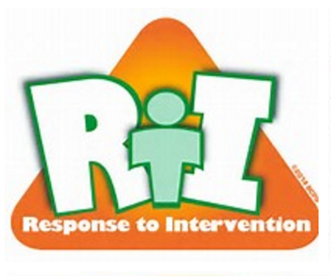
What is Response to Intervention?
Short Definition - RTI Involves:
  Regularly assessing proficiency in a skill,
  Determining which students are behind
  Providing help in small groups for those students below benchmark,
  Assessing regularly to monitor progress, an
  Intensifying instruction for students whose progress is insufficient.
Notes:
There are many components to implementing a Response to Intervention literacy model. We will discuss these later in the module. In short, RTI involves the following:
First, regularly assessing proficiency in a skill, in this case reading and oral language skills within Project LIFT schools;
Second, from this assessment, determining which students are behind expectations and benchmarks we have set for students in each grade level;
Next, providing help in small groups for those students performing below benchmark;
Then, continuing to monitor progress of these students, and intensifying instruction for students whose progress is insufficient.

Slide 4
Important Components of Response to Intervention:
High Quality, Research-Based Instruction
Outcome Oriented Research-Based Interventions
Assessments:
  Universal Screening
  Diagnostic
  Progress Monitoring
  Outcome
Systematic Data-Based Decision Making
Problem Solving Teams
Notes:
The major components of a strong RtI system are found on this slide. These are the components of the literacy framework we are trying to put into place in Project LIFT schools.
We want all teachers within schools using instruction that is high-quality and research-based. When we say research-based, we mean instruction that research has shown to be effective in building students’ literacy skills. For students who are already behind, we want to ensure that we have a system with extra instructional time built into the schedule for students who are performing below expectations to received research-based interventions in additional to the regular core reading instruction.
Another major component of RTI systems is continual assessment to determine is meeting students’ needs. We need screening assessments to determine who may need extra instruction. We need diagnostic assessments to help determine why the student(s) are behind. We need progress monitoring assessments to help determine if our interventions are being effective, and we need outcome assessments to determine how well our system is performing.
Finally we need collaboration between special education and general education by forming problem solving teams to analyze data and help determine a plan to help improve instruction for individual students as well as groups of students across various grade levels.

Slide 5
Why are we doing this . . . What is the purpose of RTI?
The purpose of RTI is to improve teaching and results for all students.
Also, another outcome of RTI is to identify students with disabilities.
  …eligibility for special education is one question that can be addressed with RTI data, and RTI does appear in the Federal IDEA statute in the section on identifying a specific learning disability (SLD).
Tilly, David W., III. Diagnosing the Learning Enabled: The Promise of Response to Intervention. Perspectives - The International Dyslexia Association
Notes:
So – a question you may be asking yourself is why do this? What is the purpose of putting an RTI system in place? First, the RTI framework goal is to improve literacy outcomes for all students across the FSM. Second, through the ongoing collection of data, another outcome may be the identification of students who have a learning disability.

Slide 6
Why are we doing this . . . What is the purpose of RTI?
RTI is a preventative approach for students who may encounter reading difficulties.
RTI improves instruction because the ongoing collection of data is closely linked to interventions that match instructional needs.
RTI provides instructional assistance in a timely fashion (not a wait-to-fail approach).
RTI helps ensure a student’s poor academic performance is not due to poor instruction or an inappropriate curriculum.
Notes:
So, why do RTI? What is the purpose of building an RTI Framework? (see bullet points)

Slide 7
Guiding Principles of
Response to Intervention:
We can effectively teach all children.
Intervene early.
Use a schoolwide, multi-tier model of service delivery.
Use a problem-solving method to make decisions within a multi-tier model.
Use research-based, scientifically validated instruction and interventions.
Monitor student progress to inform instruction.
Use data to make decisions.
Use assessment for different purposes.
Response to Intervention: Policy Considerations and Implementation. National Association of State Directors of Special Education, Inc.
Notes:
RtI is not just about the procedures, it is also about a philosophy of teaching and learning. In order for RtI to work, the staff and administration need to have the following guiding sets of beliefs:
First, we can effectively teach all children. Even if a student has a disability or less than needed support from home, your staff needs to believe that all children can improve upon their current skills.
Second, RTI systems Intervene early. They don’t wait for students to fail. Rather, effective schools assess students beginning in ECE and find students who are already behind expectations and work to move them up to grade level performance.
Schools using RTI use a schoolwide, multi-tier model of service delivery. That is, the provide extra and targeted instruction for those performing below expectations. They also use collaborative problem solving teams to make decisions within a multi-tiered instructional model.
Teachers within RTI schools use research-based, scientifically validated instruction and interventions. They attend professional development and in place new strategies and instruction that has shown to be effective.
Finally, guidelines principles of RTI include the use of progress monitoring over time in order to determine if students are making the type of progress they desire. They use this by collecting data and using this data to make instructional decisions.

Slide 8

RTI Module, Activity 1
Reflect on the Guiding Principles of RTI:
  Download and study the RTI Guiding Principles Inventory
  Rate your school on each of the principles as a 1, 2, or 3.
  What beliefs does your staff embrace and what beliefs does your staff need to work on?
  Share with your colleagues.

Slide 9
Where Did RTI Come From?
It actually is not brand new:
  Many of the practices used as part of RTI implementation have over 30 years of research.
  Earliest school-based efforts of RTI have been working on implementation for about 15-20 years (Pennsylvania, Minnesota, Iowa).
  Currently, every state indicates some emphasis on RTI either in current practice or in development.

Slide 10

Putting an RTI System in Place
What it takes:
  Consensus Building
  Infrastructure Development
  Implementation
Notes:
Before a school begins implementation of Response to Intervention, several things must first happen. First, the principal must get his or her staff on board with the initiative. Change is very difficult for many teachers, and they must first understand the purpose of RtI and how it can improve outcomes for the students they teach. They must also be assured they will be given the support they need in order to carry out what is expected of them.
Second, many of the components of RTI must be put in place before actual implementation. Just like a construction project first needs to be planned before it begins, a new school initiative such as RTI needs to be well planned and the pieces put into place before implementation. Sometimes this can take many months or a year’s time. There must be policies/procedures that clearly define how to implement Response to Intervention. This is what the Response to Intervention (RtI) Procedural Handbook is for.
Unless consensus is reached, no support will exist to establish the infrastructure. Until and unless, the infrastructure is in place, implementation will be flawed.
For this overview, we’ll start with the infrastructure development. Know, however, that Consensus Building is a key piece in development a successful RTI framework within a school building.

Slide 11
Main Idea of the RTI Model
Tier 3 - Intensive
Goal: 5-10%
Tier 2 - Strategic Goal: 15-20%
Assessment
Instruction
Tier 1 - Core Instruction
Goal: 75-80%
Problem-Solving
Notes:
As illustrated, this is the simple view of RTI. Within in are Three Main Elements of the RtI Framework:
First Assessment that accomplishes three purposes:
Benchmark Assessment of all students 3x per year to identify students who are at-risk.
Frequent progress monitoring (monthly, 2x month, weekly, etc.) for students who are below targets.
Diagnostic Assessment to help identify what to teach.
Instruction:
We need to ensure that teachers are using research-based instructional procedures. We need to ensure that districts are adopting curriculum that are research-based and well aligned to state standards. We need schools to establish a multi-tiered service delivery model.
Tier 1 (General Education) : Put in place a core curriculum that is effective for all kids
Tier 2 (General Education) : Back up the core curriculum with supplemental instruction for those in need (10-15%)
Tier 3 (Special Education) : Use intensive interventions and/or special education for students who are still not being successful (5-10%).
Problem Solving and Organization:
Use a continual problem solving process using grade level data teams to problem solve for students who are not being successful with literacy instruction

Slide 12
Developing the Infrastructure
The basic framework for RTI generally includes:
Assessment and Data Analysis
Evidence-Based Instruction
Coaching
Leadership
Professional Development
Commitment
Notes:
To make these things happen, we need to develop an infrastructure that supports the process. Let’s take a quick look at each one of these components.

Slide 13
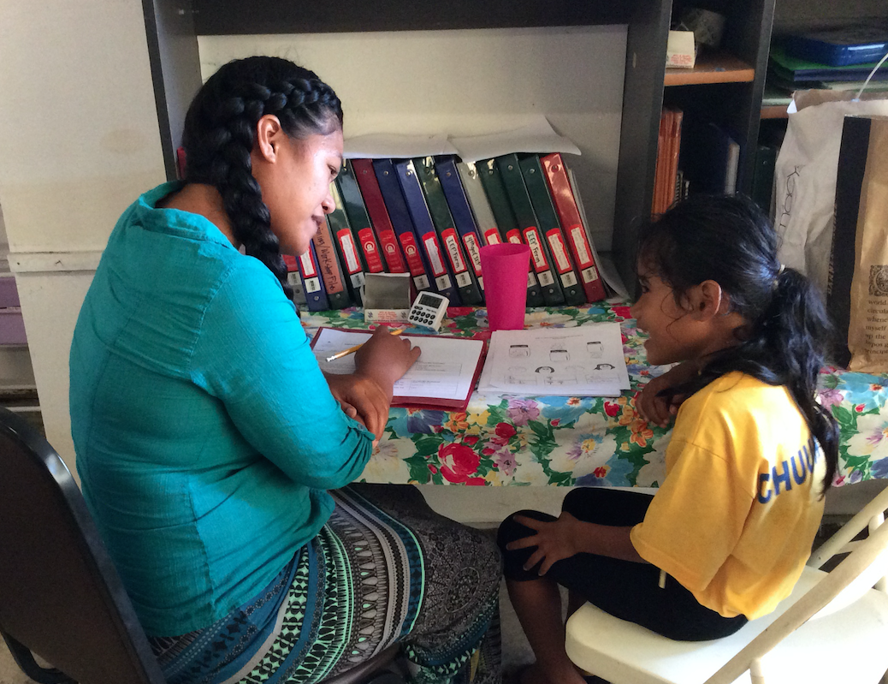
Measurement/Assessment
1. An Assessment System
A critical feature of RTI is using a measurement system that provides universal screening and frequent progress monitoring
  Screen large numbers of students
  Identify students not on track to be proficient through grade level data meetings
Notes:
A key feature in an RtI model - we don’t wait for students to be referred. Instead, the data tell us who is not on track for being proficient - this serves the screening purpose - much the same as height/weight charts serve as screening measure. We use a measurement system that is reliable, valid, simple, quick, inexpensive, easily understood, can be given frequently, and is sensitive to growth. Project LIFT has a set of screening tools for students in all grade levels. This happens three times per year
Students who meet screening benchmarks don’t need to be monitored frequently - they are progressing as we would expect. However, students not at benchmark, need their progress assessed frequently (such as weekly or every couple of weeks) to determine if the interventions we use are moving the student closer to the proficiency goal.

Slide 14
Data Analysis
Grade Level Team meetings are held to examine the latest testing information to analyze and plan instructional changes needed.
Benchmark Project LIFT goals place students in categories of:
  Benchmark
  Strategic
  Intensive
Notes:
After screening data has been collected, the process involves the RTI team meeting with different grade levels to determine which students are on track to meeting grade level goals, and who is in need of extra assistance in order to meet grade level goals.

Slide 15

Different Types of Assessment
An effective, comprehensive reading program includes reading assessments for four purposes:
  Screening
  Diagnostic
  Progress Monitoring
  Outcomes or Program Evaluation
Notes:
Project LIFT also uses other types of assessment that are build into the overall assessment plan. These include progress monitoring measures for students performing below expectations in order to determine if instruction is effective for them. Additionally, coaches and teachers are taught to use diagnostic information to determine the cause of student’s reading difficulties. If we can determine why a student is underperforming, the chances are better that we can find an instructional intervention that matches the cause. Finally, overall outcome measures are used to measure the school’s overall reading progress.

Slide 16
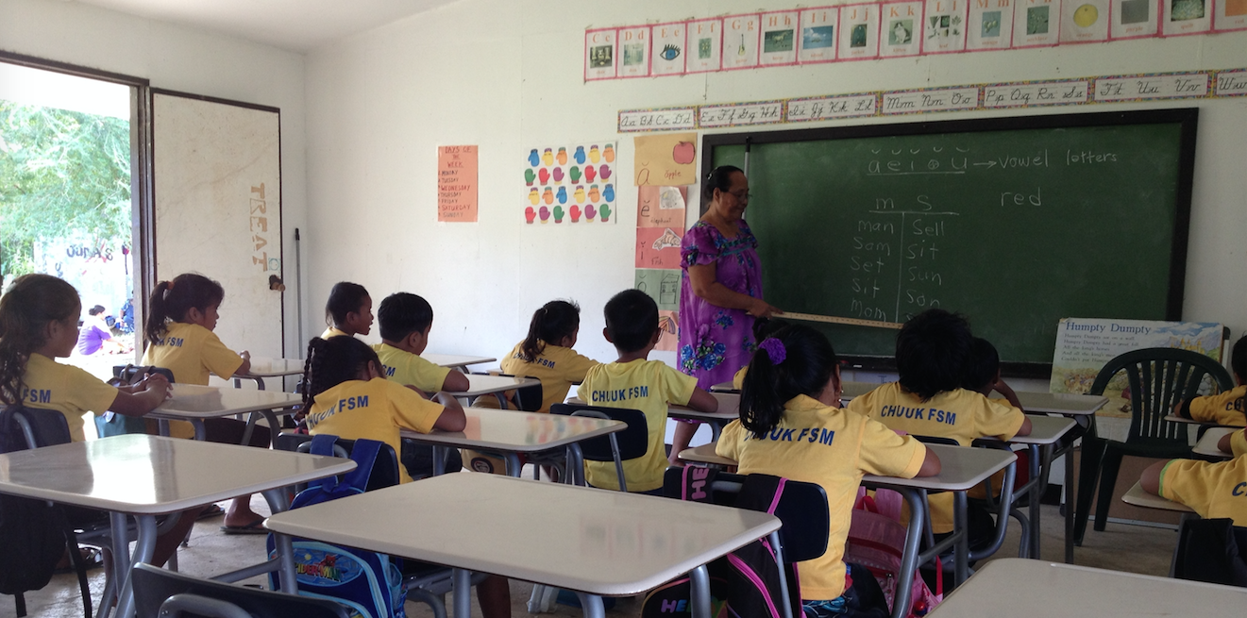
2. High-Quality Research-Based Instruction
The first assumption in an RtI model is that there is effective instruction. If not, this becomes an obvious target for improvement.
Notes:
High quality instruction that uses research as its basis is a centerpiece of Response to Intervention.
So, what is high quality instruction?

Slide 17

What is evidence-based instruction?
Instruction that is aligned with “Big Ideas” in beginning reading.
Vocabulary
Fluency
Comprehension
Phonics
Phonological Awareness
Notes:
To start, research-based instruction is instruction aligned with the essential components of reading as determine by research findings from an expert committee from the National Reading Panel Report. These include: Phonological Awareness, Phonics. Fluency, Vocabulary and Comprehension.

Slide 18
Essential Components of Reading
Phonemic Awareness: The ability to hear and manipulate sound in words.
Alphabetic Principle: The ability to associate sounds with letters and use these sounds to read words.
Accuracy and Fluency with Connected Text: The effortless, automatic ability to read words in isolation (orthographic coding) and connected text.
Vocabulary Development: The ability to understand (receptive) and use (expressive) words to acquire and convey meaning.
Comprehension: The complex cognitive process involving the intentional interaction between reader and text to extract meaning.
Notes:
On the screening you will find a short definition of each of these essential components. All are important to student outcomes, and the amount of emphasis on each of the components will differ by grade level.

Slide 19

Oral Language Development
Building English oral language and academic language skills are also very important components of Project LIFT.
Menseng mwahu.
Kuloak depe met?
It is 9:00.
Notes:
Although not one of the five essential components listed by the National Reading Panel, there is a tremendous amount of research supporting the importance of oral language development to reading and writing. As a result, there is a strong emphasis in Project LIFT on the development of oral language development.

Slide 20
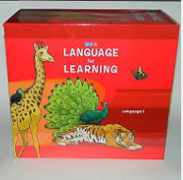

What is evidence-based instruction?
The pilot schools in Project LIFT have adopted Language for Learning in K-2 and Reading Mastery in Grades 1-3 that incorporate these skills.

Slide 21
What is evidence-based instruction?
Multi-Tier Model of Service Delivery
  Tier 1 – Our Primary Reading Program or Plan
    All students
    Preventive, proactive
  Tier 2 - Targeted Group Interventions
    Some students (some risk)
    Usually supplementing primary instruction
  Tier 3 - Intensive, Small Group and Individual Interventions
    Some students (high risk)
    Deeper problem analysis
    Highly intense instruction
Notes:
Additionally, providing extra instructional time for students who are behind is another large piece of response to intervention. This extra instruction is geared at improving the skills to are missing. Instruction in the project will also focus on development of differentiated instruction based upon student need. Teachers will deliver 20-30 minutes of daily Tier 2 and Tier 3 instruction, in addition to core reading instruction, for those students who are not meeting grade level standards. This extra time must be built into the school’s daily schedule.

Slide 22
What is evidence-based instruction?
Essential Features of Effective Instruction
Model new instructional tasks and provide explicit instruction.
Engage students during teacher-led instruction and encourage student effort.
Provide multiple opportunities for students to respond and practice new skills.
Provide immediate error correction during instruction and independent work.
Notes:
Finally, Project LIFT also emphasizes effective delivery of instruction. This includes providing explicit instruction with teacher modeling of new skills, providing multiple opportunities for students to practice newly-taught skills, actively engaging students in the classroom, effective classroom management and providing meaningful feedback to students.

Slide 23
3. Coaching
A reading coach or coach designee is available to staff to:
  Provide model teaching,
  Provide in-class support,
  Lead assessment efforts and examining data and creating intervention plans in response to the data for individuals and groups of students
  Other Responsibilities
Notes:
Literacy coaches are assigned to all Project LIFT schools. The primary functions of the coaches will be to: (a) lead grade-level teams in conducting literacy assessments and using student reading data to make decisions about reading instruction for all students; (b) provide professional development and work with teachers inside classrooms to model research-based reading instruction as well as provide feedback and support to teachers; and (c) work with the building principals in identifying professional development needs for individual teachers based upon classroom observations and student data. The primary role of the coach is not as an evaluator or supervisor, but rather an instructor and mentor.

Slide 24

4. Instructional Leadership
Strong instructional leadership at the school level maintains a focus on high-quality instruction, organizes and allocates resources to support reading, and establishes mechanisms to communicate reading progress and practices.
Notes:
Schools that are successful using a Response to Intervention framework for literacy instruction have strong instructional leadership. School principals are seen as instructional leaders, and not just simply instructional managers of the school.
School principals and coaches ensures that high quality instruction is happening in all classrooms. If not, she or he develops a plan for the teacher to become more effective rather than simply conduct business as usual. They are strong communicators who not only maintain positive communication with their teaching staff, but communicate reading progress to parents and the community as a whole. They are also knowledgeable about organizing the school and its resources to make the most out of the resources that are available.
become knowledgeable about reading standards, strategies, assessment measures and practices, and instructional programs and materials used within the school by attending and taking part in all professional development activities.

Slide 25
Instructional Leadership
    Principals become knowledgeable about reading standards, strategies, assessment measures and practices, and instructional programs and materials used within the school by attending and taking part in professional development activities.
    It is difficult to provide feedback without knowledge of reading assessments and effective instructional practices.

Slide 26
Instructional Leadership
School administrators and/or reading coaches consistently visit classrooms during the reading block and intervention reading times to provide feedback on teaching performance and student progress.
For more on this topic, please see the separate module on Principal Walk-Through
Please see the handout entitled “Using Classroom Walk-Throughs to Improve Instruction” for an overview of this topic.
Notes:
Effective instructional leaders visit classrooms on a daily basis. They observe and provide feedback to teachers on reading instruction around a variety of topics. Because this is such an important component of leadership within an RTI reading framework, a separate training module has been developed for this topic. It provides a variety of helpful information and resources for principals and coaches when conducting ”walk-through” observations during reading instruction.

Slide 27
5. Professional Development
Initial and ongoing professional development is available to support reading instruction.
Professional Development (PD) activities should be purposeful and carefully planned within the state and school of the participants. PD activities should be assessment-driven.
Onsite and online professional development at projectlift.weebly.com
Notes:
Improving reading instruction is a major goal of the project. As such, professional development will be a an important component of developing the framework for RTI – particularly within the first few years of implementation.
Time must be prioritized to allow needed professional development activities which currently are provided both onsite and remotely. A website has been developed which houses professional development and other activities.
Topics will focus on research-based practices on the topics discussed above as well as issues needing to be addressed based upon student data and classroom observations from coaches and building principals.

Slide 28

6. Commitment
All school personnel are committed to the school’s summative and formative goals, and the school promotes a culture of shared responsibility that makes it possible for all students reach these goals.
Notes:
The final component of Response to Intervention is gaining a commitment by all of those involved, including leadership and teaching personnel, to achieving the school’s new literacy goals. This may likely involves making changes to the way the school and teaching staff have traditionally functioned. It means commitment to learning new ways to teach, new ways to assess students, and increased time commitments.

Slide 29
Commitment
Commitment from State DOE staff to support the school’s implementation of RTI
Commitment to a shared responsibility for student achievement by general education and special education
Commitment to the key principles of RTI as discussed earlier in this module
Commitment by all staff to do whatever it takes to improve the literacy outcomes of the students and families they serve
Notes:
The building and implementation of a Response to Intervention framework also requires other commitments. These include:
Commitment from State DOE staff to support the school’s implementation of RTI
Commitment to a shared responsibility for student achievement by general education and special education
Commitment to the key principles of RTI as discussed earlier in this module
Commitment by all staff to do whatever it takes to improve the literacy outcomes of the students and families they serve

Slide 30
In Conclusion…
RTI takes time to develop.
If you are just beginning, there will be difficulties as change is hard.
Resources are available to learn much more about Response to Intervention.
You will receive support.
Notes:
This has been just an overview of the components of Response to Intervention as used with Project LIFT. More training and information is available on all of these topics.

Slide 31
In Conclusion…
Please move on to Part 2 of this module. Part 2 provides more information geared specifically around the principal’s role in RTI. (Coming)

